Slide 1


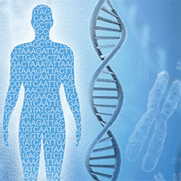
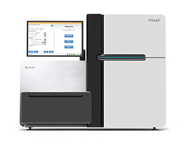
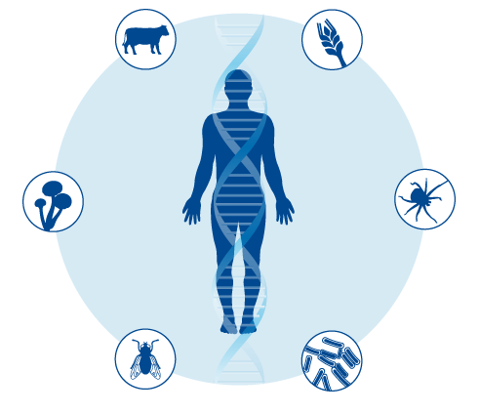
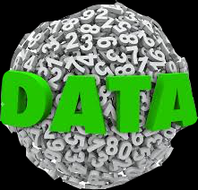
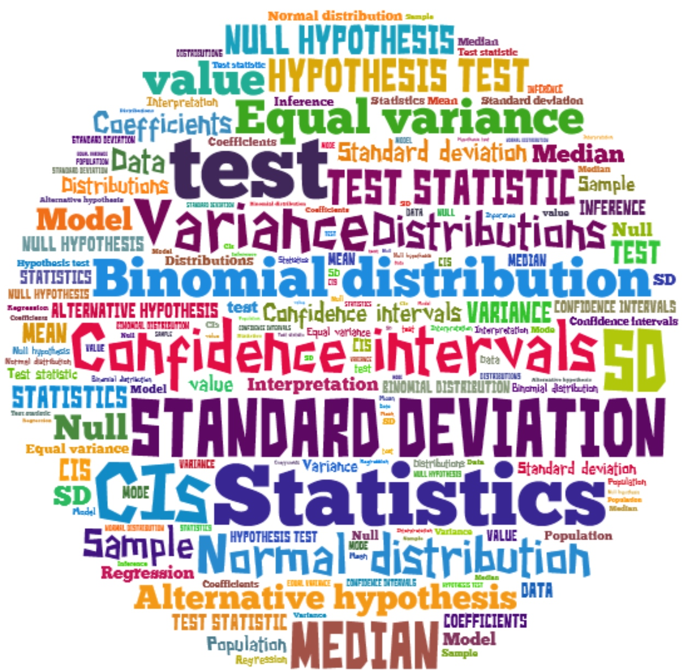
Bioinformatics and Genome Analyses course
Institut Pasteur de Tunis
Sept 18 – Dec 15, 2017
Biology:
basic and novel key concepts
Fatma Guerfali
fatma.guerfali@pasteur.tn
BCGA course– IPT – 2nd Oct 2017

Slide 2
Overview
Part 1
Introduction
Part 2
The DNA molecule
Part 3
RNA: from central dogma to new functional properties
Part 4
Proteins
Part 5
Point mutations and their consequences
Fatma Guerfali
BCGA course – IPT – 2nd Oct 2017

Slide 3
Part 1
Introduction
Fatma Guerfali
BCGA course – IPT – 2nd Oct 2017

Slide 4

Biology: key actors
What are the key actors in biology?
DNA, RNA, Proteins
DNA
RNA
Protein
Fatma Guerfali
BCGA course – IPT – 2nd Oct 2017
Code for the hereditary information
Central dogma/ novel multiple functions
multiple functions in a cell
Adapted from http://www.acecgtdiagnostic.com/facility-and-technology.html

Slide 5
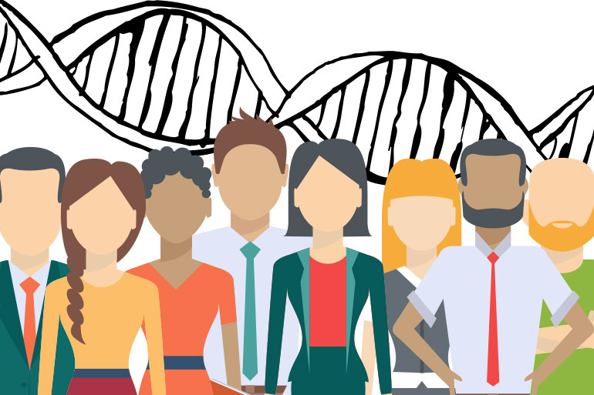
DNA, RNA, Proteins: the key to diversity
Why do we need knowledge about DNA, RNA & Proteins ?
Explain what determines the complexity of living organisms, etc…
Humans as an example:
No two individuals are similar:
What determines their different characteristics ?
What determines their different susceptibility to diseases?
DNA
RNA
Proteins
Fatma Guerfali
BCGA course – IPT – 2nd Oct 2017
http://whyfiles.org/2015/eight-ways-microbes-keep-you-healthy/

Slide 6
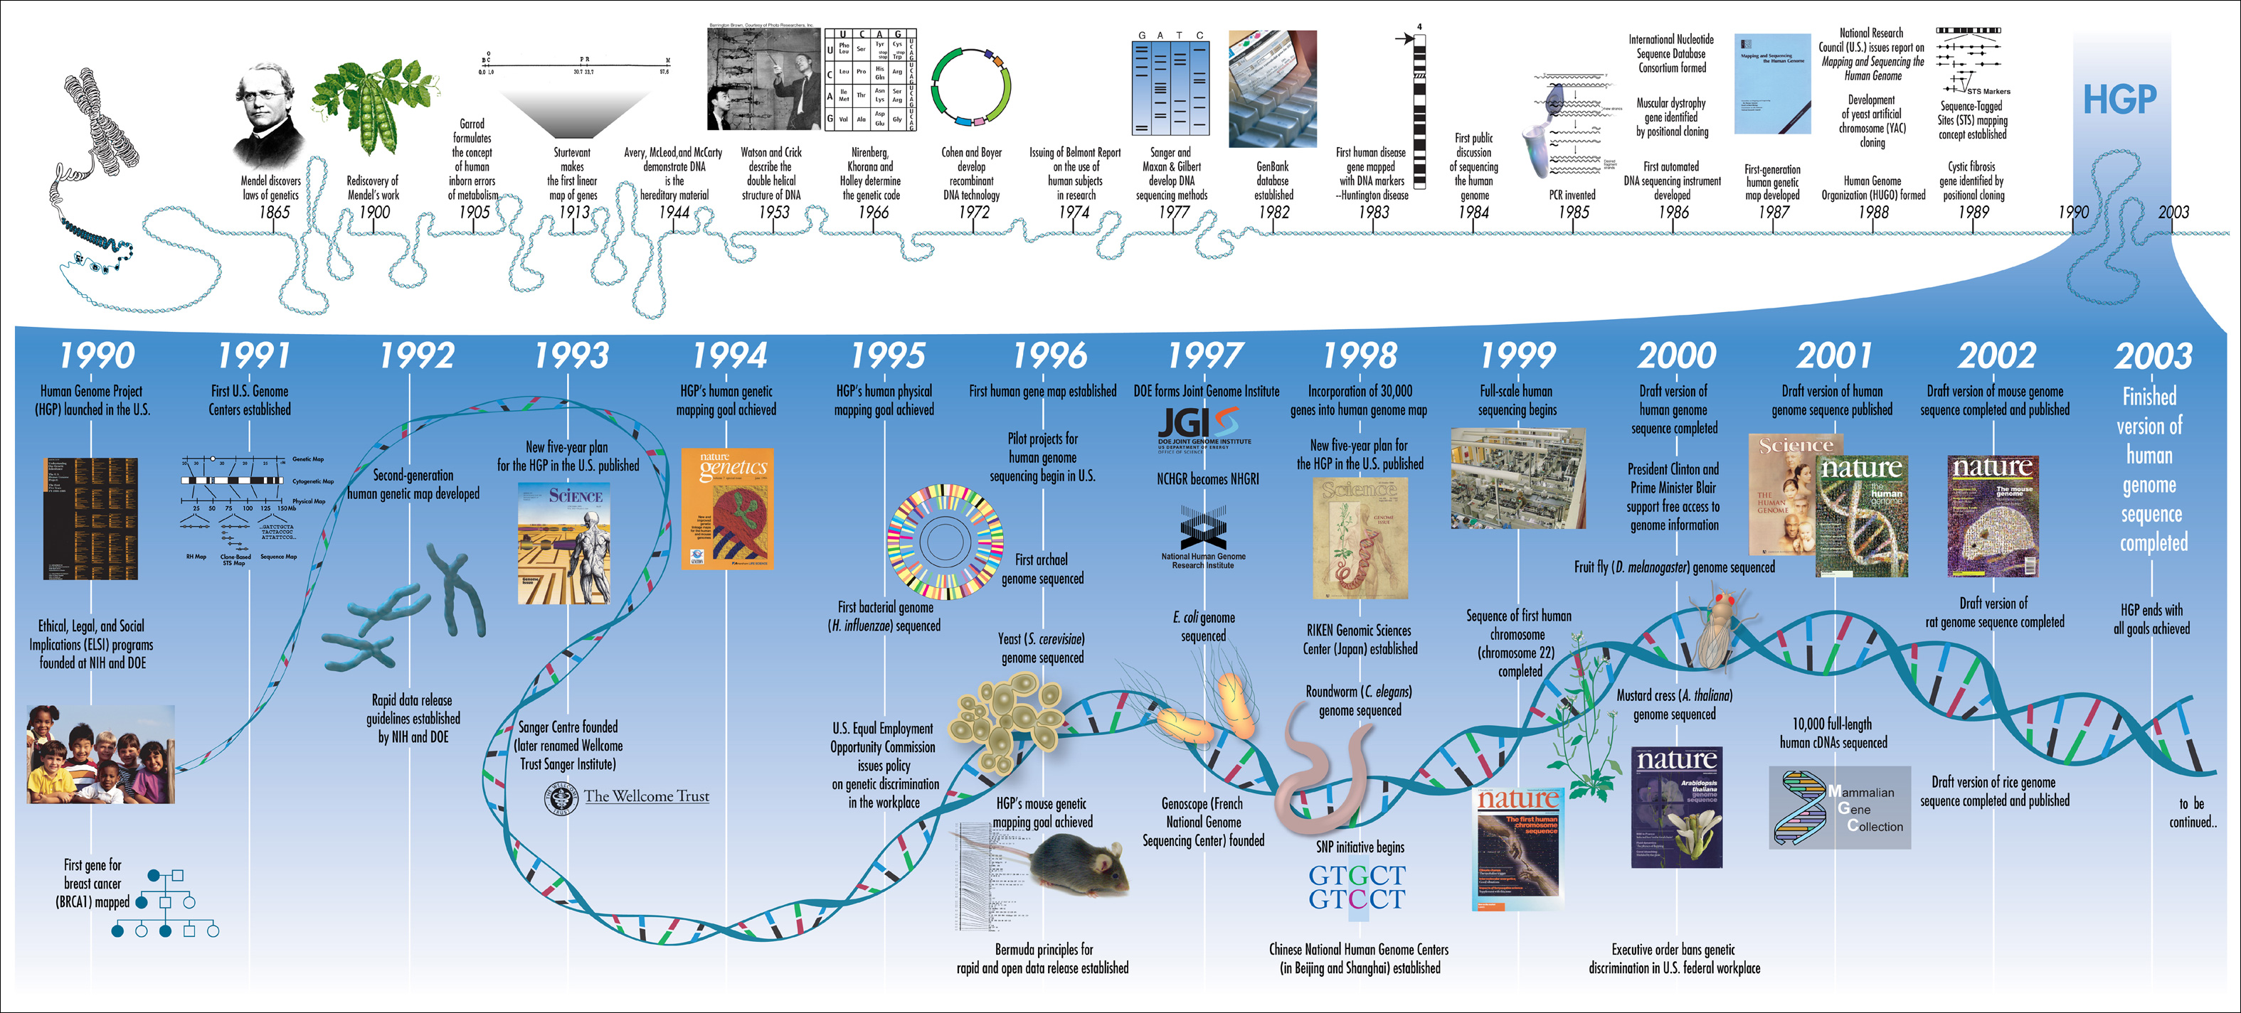
DNA knowledge: a constant evolution
• Discovery of genetics laws (Mendel)
• Discovery of the double helix structure of DNA
• Technologies: recombinant DNA, PCR
• Relationship between genes and diseases …
Fatma Guerfali
BCGA course – IPT – 2nd Oct 2017
https://exploreable.files.wordpress.com/2011/05/hgp-summary.jpg

Slide 7
DNA knowledge: a constant evolution
1953
1972
WATSON & CRICK DNA DOUBLE HELIX STRUCTURE
MIN JOU & al 1st COMPLETE GENE
BACTERIOPHAGE MS2
...
1950
1960
1976
1970
FIERS & al 1st COMPLETE GENOME BACTERIOPHAGE MS2 (VIRAL RNA 3,569 nt)
1995
VENTER & al 1st COMPLETE GENOME OF H. INFLUENZAE (BACTERIUM, CIRCULAR CHR >1,8Mb)
1977
SANGER & al 1st COMPLETE DNA GENOME BACTERIOPHAGE φX174
Fatma Guerfali
BCGA course – IPT – 2nd Oct 2017
1977
1995-96
1st PUBLISHED USE OF WGS SEQUENCING (1995)
1st NGS TECHNOLOGY PYROSEQUENCING (1996)
1987
1990
ABI markets ABI370, the 1st fully automated sequencing machinE
1980
SANGER SEQUENCING
+ MAXAM & GILBERT
2001
HUMAN GENOME PROJECT
1st DRAFT SEQUENCE FROM
PUBLIC (Lander et al.,Nature)
& PRIVATE (Venter et al.,Science)
1000 GENOME
PROJECT
UK10K
PROJECT
2000
2005
454 GS20 PYROSEQUENCER
2014
HiSeq X Ten (ILLUMINA)
$1,000 HUMAN GENOME
HAPMAP
PROJECT
ENCODE
PROJECT
2006
SOLEXA GA1 (ILLUMINA)
2007
SOLID (ABI)
2009-2010
HiSeq 2000 (ILLUMINA) PACBIO

Slide 8
Part 2
The DNA molecule
Fatma Guerfali
BCGA course – IPT – 2nd Oct 2017

Slide 9
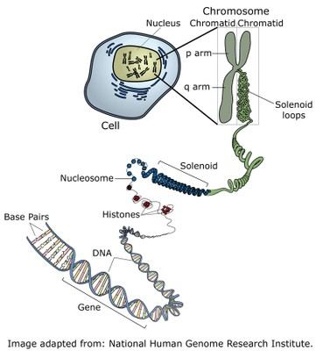
DNA
The DNA molecule
DNA (or deoxyribonucleic acid) is the molecule that carries the genetic information in all cellular forms of life and some viruses.
Fatma Guerfali
BCGA course – IPT – 2nd Oct 2017
http://www2.le.ac.uk/projects/vgec/highereducation/topics/dna-genes-chromosomes

Slide 10
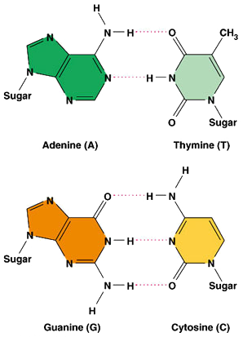
DNA
The DNA molecule
The DNA molecule belongs to a class of molecules called the nucleic acids, which are polynucleotides - that is, long chains of nucleotides.
Each nucleotide consists of three components:
a nitrogenous base: cytosine (C), guanine (G), adenine (A) or thymine (T)
a five-carbon sugar molecule (deoxyribose in the case of DNA)
a phosphate molecule
Fatma Guerfali
BCGA course – IPT – 2nd Oct 2017
http://www.councilforresponsiblegenetics.org/
http://www2.le.ac.uk/projects/vgec/highereducation/topics/dna-genes-chromosomes

Slide 11
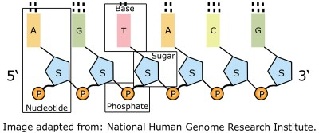
DNA
The DNA molecule
In the DNA molecule, the backbone of the polynucleotide is a chain of sugar and phosphate molecules.
Each of the sugar groups in this sugar-phosphate backbone is linked to one of the four nitrogenous bases.
Directionality along the backbone : 5’ (phosphate) → 3’ (OH)
Fatma Guerfali
BCGA course – IPT – 2nd Oct 2017
http://www2.le.ac.uk/projects/vgec/highereducation/topics/dna-genes-chromosomes

Slide 12
DNA
The DNA molecule
Base-pairing and strand interactions
A, G are long (double ring purines)
C,T are short (single ring pyrimidines)
need one long and one short nucleotide per pair
C-G have three hydrogen bonds (slightly stronger matching)
- A-T have two hydrogen bonds (slightly weaker matching)
Fatma Guerfali
BCGA course – IPT – 2nd Oct 2017
http://www2.le.ac.uk/projects/vgec/highereducation/topics/dna-genes-chromosomes
https://engineering.ucsb.edu/~shell/che170/DNA-notes.pdf

Slide 13
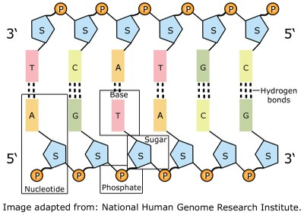
DNA
The DNA molecule
Complementarity in base-pairing : The bases link across the two strands in a specific manner using hydrogen bonds: cytosine (C) pairs with guanine (G), and adenine (A) pairs with thymine (T).
Purines: A, G
Pyrimidines: T, C (U instead of T in RNA)
A different number of hydrogen bonds
links the bases
Antiparallel orientation:
1 strand is 5’ → 3’
1 strand is 3’ → 5’
Fatma Guerfali
BCGA course – IPT – 2nd Oct 2017
http://www2.le.ac.uk/projects/vgec/highereducation/topics/dna-genes-chromosomes

Slide 14
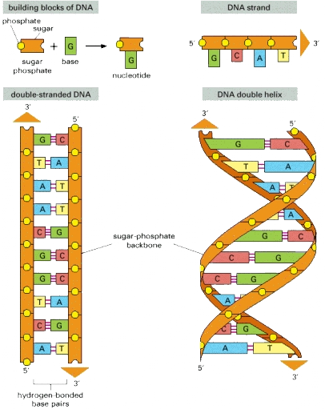
DNA
The DNA molecule
Helical shape
- 10.4 nucleotides per turn
- diameter = 2 nm
- both major and minor grooves
called B-DNA.
- The helix twist and diameter can also change under dehydrating conditions and methylation to A-DNA and Z-DNA
Fatma Guerfali
BCGA course – IPT – 2nd Oct 2017
http://www2.le.ac.uk/projects/vgec/highereducation/topics/dna-genes-chromosomes
https://engineering.ucsb.edu/~shell/che170/DNA-notes.pdf

Slide 15
DNA
The DNA molecule
In brief:
The nucleotide (P-sugar+base) is the minimal building block of DNA.
Hydrogen bonding modes presented here follow the classical Watson–Crick base pairing
The DNA is double-stranded and organized in a double-helix
It is the order of the bases along a single strand that constitutes the genetic code.
Fatma Guerfali
BCGA course – IPT – 2nd Oct 2017
http://www.councilforresponsiblegenetics.org/

Slide 16
DNA
The DNA molecule organization
Information in DNA sequence is the genome
The chromosomes of prokaryotic cells are not enclosed by a separate membrane. The chromosome - together with ribosomes and proteins associated with gene expression - is located in a region of the cell cytoplasm known as the nucleoid.
In bacteria, genome usually circular. Most bacteria contain a single, circular chromosome. (examples of exceptions: Streptomyces possess linear chromosomes, and Vibrio cholerae has two circular chromosomes)
The genomes of prokaryotes are compact compared with those of eukaryotes, as they lack introns, and the genes tend to be expressed in groups known as operons.
In addition to the main chromosome, bacteria are also characterised by the presence of extra-chromosomal genetic elements called plasmids.
Fatma Guerfali
BCGA course – IPT – 2nd Oct 2017
https://engineering.ucsb.edu/~shell/che170/DNA-notes.pdf
http://www2.le.ac.uk/projects/vgec/highereducation/topics/dna-genes-chromosomes
Notes:
The prokaryotes (Greek for 'before nucleus' - including Eubacteria and Archaea)

Slide 17
DNA
The DNA molecule organization
• The genome in eukaryotes is organized into chromosomes
each chromosome is a separate DNA molecule
Chromosomes extended and replicated during interphase portion of the cell cycle􏰀
chromosomes are condensed, visible with light during cell division (M phase)
Each chromosome has a p arm and a q arm. In their replicated form, each chromosome consists of two chromatids.
Specific sequences have particular roles in chromosomes:
Centromers (center “pinch point” of a chromosome that allows one copy of each to be pulled apart into two daughter cells during division)
Telomers (specialized sequences at the chromosomes end that facilitate replication)
Replication origins (multiple locations where the replication machinery first binds)
Fatma Guerfali
BCGA course – IPT – 2nd Oct 2017
https://engineering.ucsb.edu/~shell/che170/DNA-notes.pdf
http://www2.le.ac.uk/projects/vgec/highereducation/topics/dna-genes-chromosomes

Slide 18
DNA
The DNA molecule organization
The genome contains coding and non-coding regions
The complexity of non-coding regions is higher in higher eukaryotes
The coding regions contains genes (about 20,000 in the human genome)
Genes can code for RNAs or for proteins as a final product
Central dogma in molecular biology:
Remember the central dogma of biology: DNA (genetic information in genes)􏰀 → RNA (copies of genes)􏰀 → proteins (functional molecules)
Completely changed after the HGP !!!
Fatma Guerfali
BCGA course – IPT – 2nd Oct 2017
https://engineering.ucsb.edu/~shell/che170/DNA-notes.pdf

Slide 19
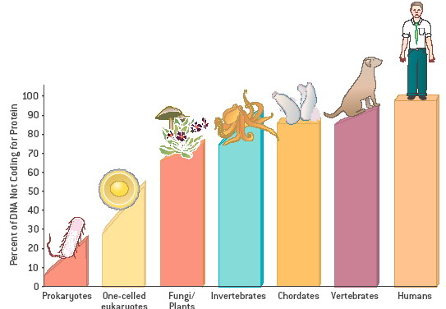
DNA
Coding vs non-coding
PROTEIN
CODING DNA
NON-PROTEIN CODING DNA
The proportion of non-coding DNA increases with organism complexity
Fatma Guerfali
BCGA course – IPT – 2nd Oct 2017
≈ 20,000
The human genome contains only about 20,000 protein-coding genes : sequence alone is not enough to explain the whole complexity !
(Mattick, 2011)
http://www.yourgenome.org/stories/how-is-the-completed-human-genome-sequence-being-used

Slide 20
DNA
Coding vs non-coding
PROTEIN
CODING DNA
Genes
Basic physical and functional unit of heredity.
Genes consist of three types of nucleotide sequence:
coding regions, called exons, which specify a sequence of amino acids
non-coding regions, called introns, which do not specify amino acids
regulatory sequences: determine when and where the protein is made + how much
NON-PROTEIN CODING DNA
Fatma Guerfali
BCGA course – IPT – 2nd Oct 2017
≈ 20,000
The human genome contains only about 20,000 protein-coding genes : sequence alone is not enough to explain the whole complexity !
(Mattick, 2011)
http://www2.le.ac.uk/projects/vgec/highereducation/topics/dna-genes-chromosomes

Slide 21
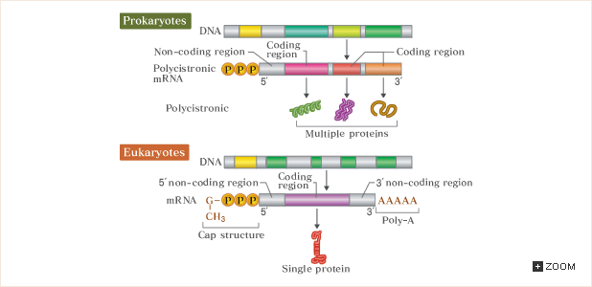
DNA
Genes
Fatma Guerfali
BCGA course – IPT – 2nd Oct 2017
Prokaryotes
“cistron” = gene
“operon” = a gene unit controlled for gene expression by the same regulating region (e.g. Lactose, Histidine : if present in the medium, the prokarotic cell supress all genes related to its synthesis by the genes in operon).
http://csls-text.c.u-tokyo.ac.jp/active/04_02.html

Slide 22
DNA
Genes
Fatma Guerfali
BCGA course – IPT – 2nd Oct 2017
Eukaryotes
In general: Eukaryotes do not have operons and hence no polycistronic RNA is generated
→ Exceptions !!!! (Leishmania)
http://csls-text.c.u-tokyo.ac.jp/active/04_02.html

Slide 23
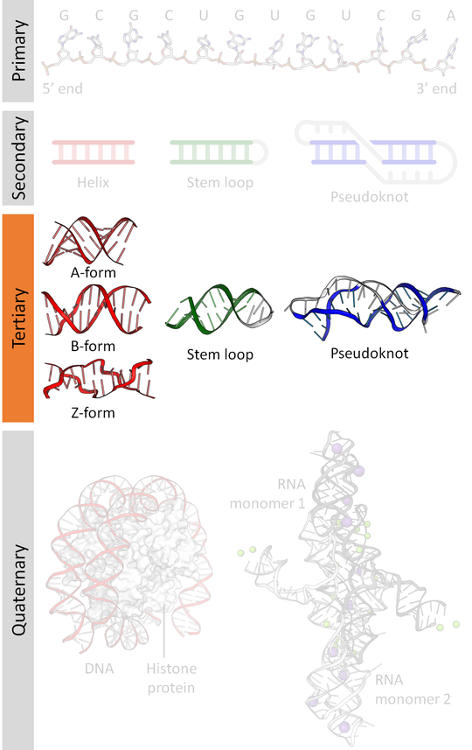
DNA
The DNA molecule regulation
Primary, Secondary, Tertiary and Quaternary structures
The genome can contain methylated regions
Organization in the nucleus
Fatma Guerfali
BCGA course – IPT – 2nd Oct 2017
https://engineering.ucsb.edu/~shell/che170/DNA-notes.pdf

Slide 24
DNA
The DNA molecule is in an active reshaping
The information contained in the DNA as a specific occurrence of sequences or a genetic code is frequently referred to as a "blueprint" because it contains the instructions a cell requires in order to sustain itself.
Evidence demonstrate that informations stored at the DNA level is the basis for the production of various molecules, including DNA itself, RNA and protein.
DNA replication
DNA transcription
DNA translation
Fatma Guerfali
BCGA course – IPT – 2nd Oct 2017
https://www.nature.com/scitable/topicpage/dna-transcription-426

Slide 25
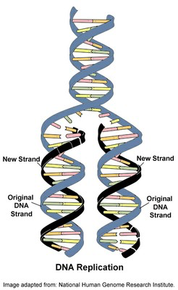
DNA
The DNA molecule is in an active reshaping
DNA replication
DNA replication is the biological process of producing two identical replicas of DNA from one original DNA molecule. This process occurs in all living organisms and is the basis for biological inheritance.
The enzyme helicase breaks the hydrogen bonds holding the two strands together, and both strands can then act as templates for the production of the opposite strand. The process is catalysed by the enzyme DNA polymerase, and includes a proofreading mechanism.
Fatma Guerfali
BCGA course – IPT – 2nd Oct 2017
http://www2.le.ac.uk/projects/vgec/highereducation/topics/dna-genes-chromosomes
https://en.wikipedia.org/wiki/DNA_replication

Slide 26
DNA
The DNA molecule is in an active reshaping
DNA replication
Error-correction machinery
mutations occur 1 in 10􏰁⁹ nucleotides copied → evolution, cancer
DNA polymerase proofreads to make sure correct nucleotide is added􏰀 → if not, it excises and goes back to add the correct one
Mismatch repair machinery fixes incorrectly added nucleotides not found by DNA polymerase􏰀 → detects nicks in newly created strand
Damage to DNA continuously occurs
Homologous recombination uses similar sequences in nearby strands in order to fill in excised damaged DNA
also the basis of heredity
Fatma Guerfali
BCGA course – IPT – 2nd Oct 2017
https://engineering.ucsb.edu/~shell/che170/DNA-notes.pdf

Slide 27
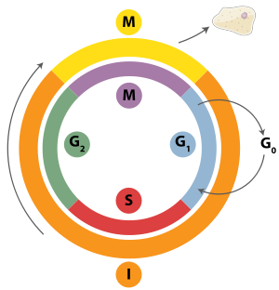
DNA
The DNA molecule is in an active reshaping
DNA replication
Eukaryotes
Within eukaryotes, DNA replication is controlled within the context of the cell cycle and occurs at the S phase (synthetic phase).
Several checkpoints (cyclins) control the progression of the cell through its cell cycle. The G1/S checkpoints controls entry in replication, or remaining in the G0 stage.
Replication of chloroplast and mitochondrial genomes occurs independently of the cell cycle, through the process of D-loop replication.
Fatma Guerfali
BCGA course – IPT – 2nd Oct 2017
http://www2.le.ac.uk/projects/vgec/highereducation/topics/dna-genes-chromosomes
https://en.wikipedia.org/wiki/DNA_replication

Slide 28
DNA
The DNA molecule is in an active reshaping
DNA replication
Eukaryotes
In vertebrate cells, replication sites concentrate into positions called replication foci.
Eukaryotes initiate DNA replication at multiple points in the chromosome, so replication forks meet and terminate at many points in the chromosome.
Fatma Guerfali
BCGA course – IPT – 2nd Oct 2017
http://www2.le.ac.uk/projects/vgec/highereducation/topics/dna-genes-chromosomes
https://en.wikipedia.org/wiki/DNA_replication

Slide 29
DNA
The DNA molecule is in an active reshaping
DNA replication
Eukaryotes
Because eukaryotes have linear chromosomes, DNA replication is unable to reach the very end of the chromosomes, but ends at the telomere region of repetitive DNA close to the ends.
This shortens the telomere of the daughter DNA strand. Shortening of the telomeres is a normal process in somatic cells. As a result, cells can only divide a certain number of times before the DNA loss prevents further division (known as the Hayflick limit).
Fatma Guerfali
BCGA course – IPT – 2nd Oct 2017
http://www2.le.ac.uk/projects/vgec/highereducation/topics/dna-genes-chromosomes
https://en.wikipedia.org/wiki/DNA_replication

Slide 30
DNA
The DNA molecule is in an active reshaping
DNA replication
Eukaryotes
Within the germ cell line, which passes DNA to the next generation, telomerase extends the repetitive sequences of the telomere region to prevent degradation.
Telomerase can become mistakenly active in somatic cells, sometimes leading to cancer formation. Increased telomerase activity is one of the hallmarks of cancer.
Fatma Guerfali
BCGA course – IPT – 2nd Oct 2017
http://www2.le.ac.uk/projects/vgec/highereducation/topics/dna-genes-chromosomes
https://en.wikipedia.org/wiki/DNA_replication

Slide 31
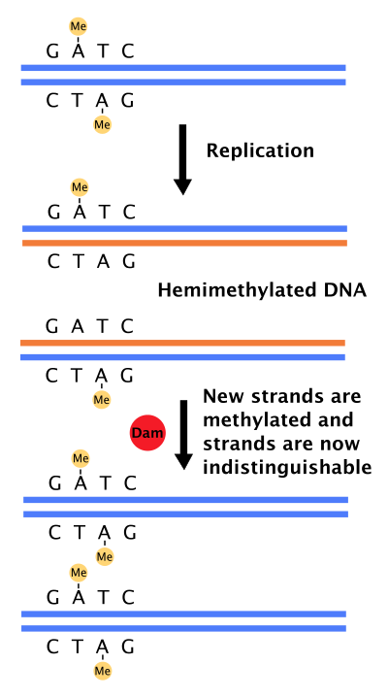
DNA
The DNA molecule is in an active reshaping
DNA replication
Prokaryotes
Most bacteria do not go through a well-defined cell cycle but instead continuously copy their DNA → during rapid growth : concurrent occurrence of multiple rounds of replication.
In E. coli, DNA replication is regulated through several mechanisms, including:
the hemimethylation (E. coli methylates GATC) and sequestering of the origin sequence, (SeqA recognizes hemiCH3 and binds to this origin)
the levels of protein DnaA. (DNAa required for replication initiation poorly recognizeshemiCH3 and prevents immediate reinitiation).
Fatma Guerfali
BCGA course – IPT – 2nd Oct 2017
https://en.wikipedia.org/wiki/DNA_replication
Notes:
In E. coli, the best-characterized bacteria…
(including the hemiethylation, the ratio of adenosine triphosphate (ATP) to adenosine diphosphate (ADP), and the levels of protein DNAa
All these control the binding of initiator proteins to the origin sequences.

Slide 32
DNA
The DNA molecule is in an active reshaping
DNA transcription
In transcription, a portion of the double-stranded DNA template gives rise to a single-stranded RNA molecule.
In some cases, the RNA molecule itself is a "finished product" that serves some important function within the cell.
Transcription involves the synthesis of rRNA from DNA using RNA polymerase
RNA polymerase must unpair and unwind DNA as it is reading it
much less accurate than replication → errors of 1 in 10^{􏰂4}
protein synthesis can tolerate more errors
multiple RNAs can be sequenced from the same gene at the same time
Fatma Guerfali
BCGA course – IPT – 2nd Oct 2017
https://engineering.ucsb.edu/~shell/che170/DNA-notes.pdf

Slide 33
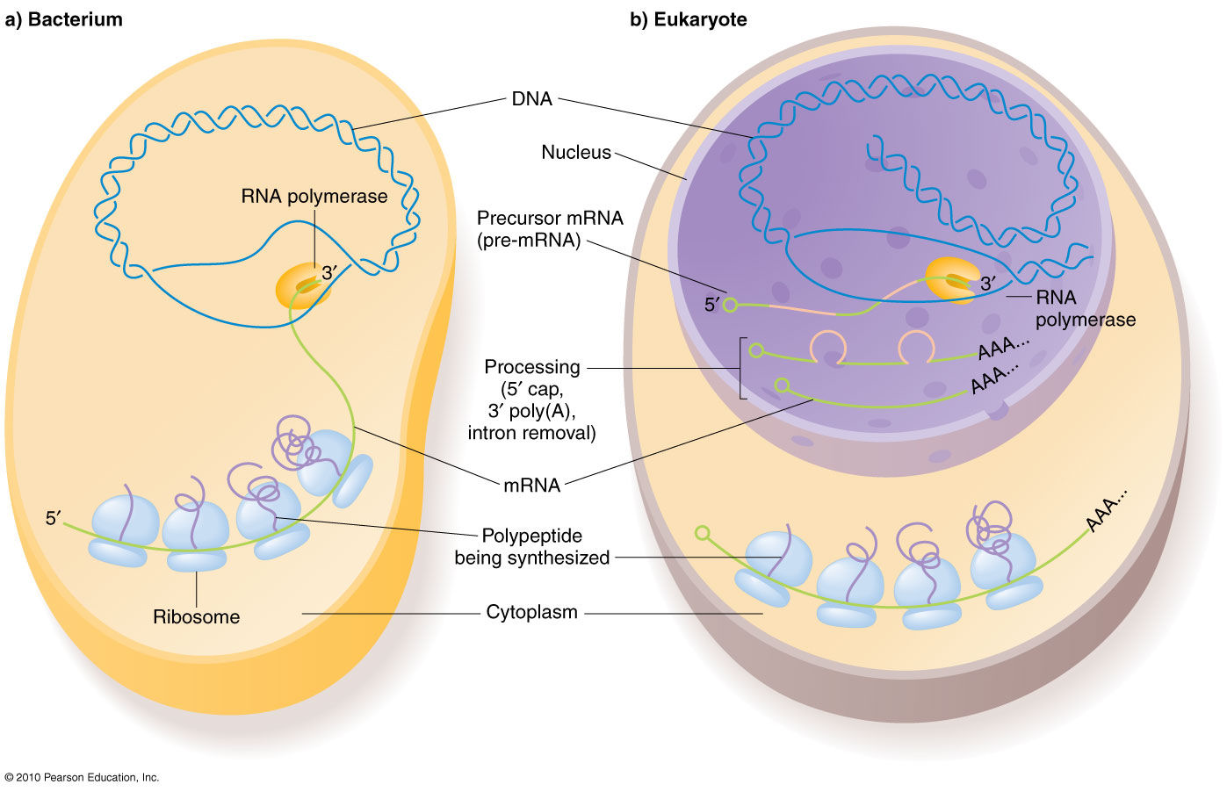
DNA
The DNA molecule is in an active reshaping
DNA transcription
Fatma Guerfali
BCGA course – IPT – 2nd Oct 2017
Whereas bacteria have only one RNA polymerase, 3 different types of RNA polymerase exist in eukaryotic cells.
RNA pol I →genes that encode most of the rRNAs
RNA pol II → mRNAs, which serve as the templates for production of protein molecules.
RNA pol III → genes for one small rRNA, plus the tRNAs that play a key role in the translation process, as well as other small regulatory RNA molecules.
https://www.mun.ca/biology/scarr/iGen3_05-09.html

Slide 34
DNA
The DNA molecule is in an active reshaping
DNA transcription
Prokaryotes
RNA polymerase binds to specific regions of the DNA called promoters, specific nucleotide sequences
Promoters orient polymerase in a specific direction
RNA polymerase binds to the promoter with the help of an accessory protein, called a sigma factor
Synthesis stops at a terminator sequence, typically of poly A-T stretches of DNA
Fatma Guerfali
BCGA course – IPT – 2nd Oct 2017
https://engineering.ucsb.edu/~shell/che170/DNA-notes.pdf
Notes:
RNA transcript is synthesized by ribonucleotide triphosphate additions

Slide 35
DNA
The DNA molecule is in an active reshaping
DNA transcription
Eukaryotes
Different kinds of RNA polymerases
RNA polymerase requires transcription factors (TFs) : helper proteins → TFs : assemble to form a large transcription complex (TFIID binds to TATA box…)
Chromatin-remodeling proteins are involved to make DNA accessible from the wound histone structure
RNA chemically modified with a methylated guanine at the 5’ end and a poly-A sequence at the 3’ end → necessary for translation
RNA is processed after synthesis → splicing to remove noncoding regions called introns → important : promotes diversity
Fatma Guerfali
BCGA course – IPT – 2nd Oct 2017
https://engineering.ucsb.edu/~shell/che170/DNA-notes.pdf
Notes:
RNA transcript is synthesized by ribonucleotide triphosphate additions
The nuclear pore complex selectively exports complete, spliced mRNA molecules to the cytosol

Slide 36
DNA
The DNA molecule is in an active reshaping
DNA transcription
RNA has some distinctions from DNA
ribose rather than deoxyribose sugar (differs in an OH group)
uracil instead of thymine (loss of a methyl group)
wobble base pairing : pairing between two nucleotides in RNA molecules that does not follow Watson-Crick base pair rules : (G-U), (I-U), (I-A), (I-C) → fundamental in RNA secondary structure and critical for a proper translation
single-stranded, and typically folds into unique shapes, like proteins
less chemically stable
Fatma Guerfali
BCGA course – IPT – 2nd Oct 2017
https://engineering.ucsb.edu/~shell/che170/DNA-notes.pdf
https://en.wikipedia.org/wiki/Wobble_base_pair
Notes:
The four main wobble base pairs are guanine-uracil (G-U), hypoxanthine-uracil (I-U), hypoxanthine-adenine (I-A), and hypoxanthine-cytosine (I-C).

Slide 37
DNA
The DNA molecule is in an active reshaping
DNA translation
• Translation is the process in which ribosomes in the cytoplasm synthesize proteins after the transcription of DNA to RNA.
• In translation, mRNA is decoded by a ribosome, outside the nucleus, to produce a specific amino acid chain, or polypeptide → later folds into an active protein → performs its functions in the cell.
Fatma Guerfali
BCGA course – IPT – 2nd Oct 2017
https://en.wikipedia.org/wiki/Translation_(biology)
Notes:
Initiation: The ribosome assembles around the target mRNA. The first tRNA is attached at the start codon.
Elongation: The tRNA transfers an amino acid to the tRNA corresponding to the next codon. The ribosome then moves (translocates) to the next mRNA codon to continue the process, creating an amino acid chain.
Termination: When a stop codon is reached, the ribosome releases the polypeptide.

Slide 38
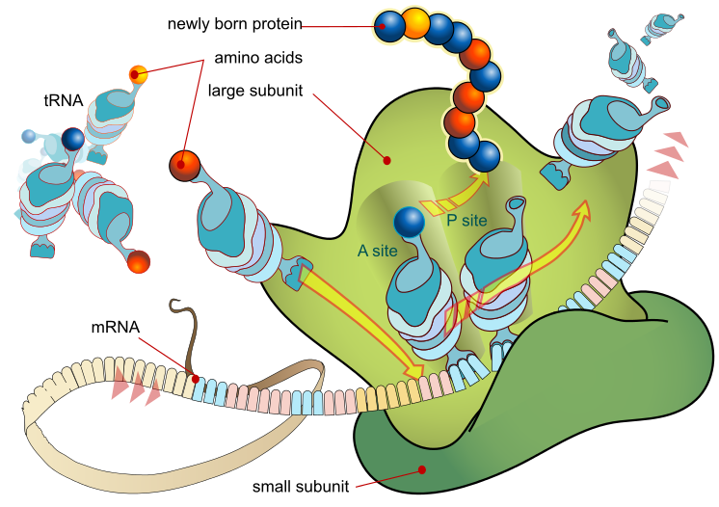
DNA
The DNA molecule is in an active reshaping
DNA translation
Translation proceeds in 3 phases:
Initiation: ribosome assembles around the target mRNA + first tRNA (complementary tRNA anticodon) attached at the mRNA start codon (Met).
Elongation: tRNA transfers aa to the tRNA of next codon → ribosome translocates to the next mRNA codon to continue the process, creating an aa chain.
Termination: stop codon reached → the ribosome releases the polypeptide.
Fatma Guerfali
BCGA course – IPT – 2nd Oct 2017
https://en.wikipedia.org/wiki/Translation_(biology)
Notes:
Initiation: The ribosome assembles around the target mRNA. The first tRNA is attached at the start codon.
Elongation: The tRNA transfers an amino acid to the tRNA corresponding to the next codon. The ribosome then moves (translocates) to the next mRNA codon to continue the process, creating an amino acid chain.
Termination: When a stop codon is reached, the ribosome releases the polypeptide.

Slide 39
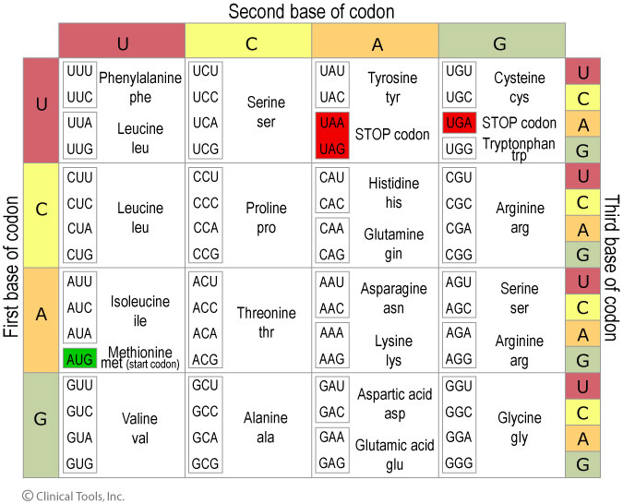
DNA
The DNA molecule is in an active reshaping
DNA translation
The genetic code is:
universal: all living organisms use this code (few minor exceptions).
degenerate. Each amino acid can be coded for by more than one codon. For example, AGA and AGG both code for the amino acid arginine.
Fatma Guerfali
BCGA course – IPT – 2nd Oct 2017
http://www2.le.ac.uk/projects/vgec/highereducation/topics/dna-genes-chromosomes
Notes:
A codon table sets out how the triplet codons code for specific amino acids.
The genetic code is written in DNA sequences as codons, groups of three nucleotides.
Each codon represents a single amino acid in a protein chain. However, there are more codons (64) than amino acids found in proteins (20), so many codons are effectively synonyms.

Slide 40
Part 3
RNA
from central dogma
to new functional properties
Fatma Guerfali
BCGA course – IPT – 2nd Oct 2017

Slide 41
RNA
Central dogmas
Proposed by Francis Crick 1958
• DNA holds the coded hereditary information in the nucleus
• This code is expressed at the ribosome during protein synthesis in the cytoplasm
• The protein produced by the genetic information is what is influenced by natural selection
• If a protein is modified it cannot influence the gene that codes for it. Therefore only one way flow of information was thought to occur:
DNARNAProtein
Fatma Guerfali
BCGA course – IPT – 2nd Oct 2017

Slide 42
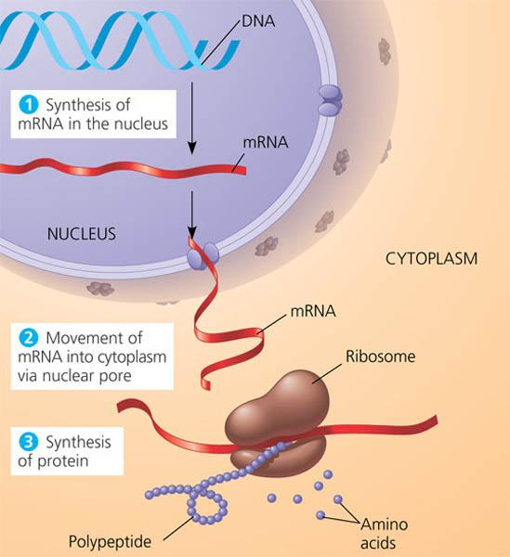
RNA
Central dogmas
Proposed by Francis Crick 1958
• What is a gene? (definition until less than 10 years ago)
Gene
Is defined as a DNA portion whose corresponding mRNA encodes a protein.
= RNA only considered to be a “bridge” in the transfer of biological information between DNA and proteins
Fatma Guerfali
BCGA course – IPT – 2nd Oct 2017
(Costa et al., 2010)

Slide 43
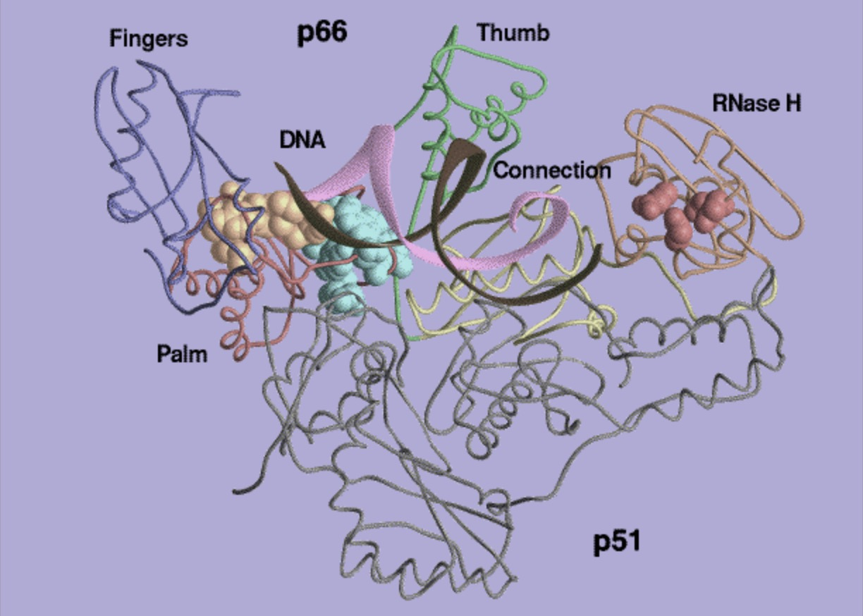
RNA
Central dogmas
Proposed by Francis Crick 1958
Retro viruses (e.g. HIV) carry RNA as their genetic information
When they invade their host cell they convert their RNA into a DNA copy using reverse transcriptase
Fatma Guerfali
BCGA course – IPT – 2nd Oct 2017
• Thus the central dogma has been modified:
DNA↔RNA→Protein
• Has helped to explain an important paradox in the evolution of life.
(Costa et al., 2010)

Slide 44
RNA
New era
RNA is no longer considered to be a “bridge” in the transfer of biological information between DNA and proteins
Transcriptome consist of
Coding RNA (mRNA (2–4%)
Previously known non-coding RNAs
ribosomal RNA (80–90%, rRNA)
transfer RNA (5–15%, tRNA)
Small fraction of of intragenic (i.e., intronic) and intergenic non-coding RNA (1%, ncRNA) with undefined regulatory functions.
Intragenic & Intergenic sequences
- Are enriched in repetitive elements
- have long been considered genetically inert
mainly composed of “junk” DNA.
Fatma Guerfali
BCGA course – IPT – 2nd Oct 2017
(Costa et al., 2010)

Slide 45
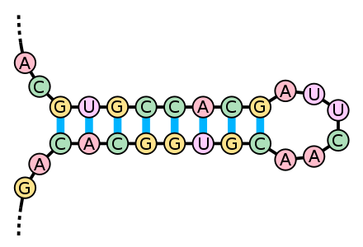
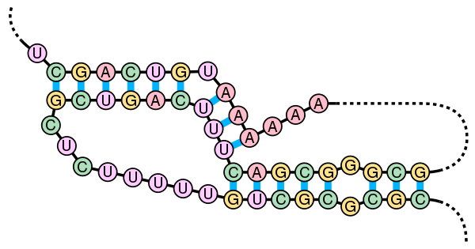
RNA
New era : understanding mechanisms of gene expression
For many RNA molecules, the secondary structure is highly important to the correct function of the RNA — often more so than the actual sequence.
stem-loop secondary structure of tRNAs
A pseudoknot is a nucleic acid secondary structure containing at least two stem-loop structures in which half of one stem is intercalated between the two halves of another stem.
RNA secondary structure applies
in RNA splicing in certain species.
To aid in the analysis of non-coding RNA
Fatma Guerfali
BCGA course – IPT – 2nd Oct 2017
https://en.wikipedia.org/wiki/Nucleic_acid_secondary_structure
Notes:
(microRNAs have canonical long stem-loop structures interrupted by small internal loops).

Slide 46
RNA
New era : understanding mechanisms of gene expression
• Cells can adapt to environment and development by reconstructing their transcriptional networks to regulate diverse cellular processes without altering the underlying DNA sequences.
• Important alterations, namely epigenetic changes, occur during cell division, differentiation and cell death.
• Epigenetic changes are governed by various types of determinants, including:
DNA methylation patterns
histone posttranslational modification signatures
histone variants
chromatin remodeling
chromosome conformation characteristics
non-coding RNAs (ncRNAs)
Fatma Guerfali
BCGA course – IPT – 2nd Oct 2017
(Cao et al., 2015. Three-dimensional regulation of transcription )

Slide 47
RNA
New era : understanding mechanisms of gene expression
Chromosome conformation characteristics
• Chromosomal interactions can contribute to the silencing and/or activation of genes within the 3D organization of the nuclear architecture.
• The genome forms extensive and dynamic physical interactions in the form of chromatin loops and bridges.
brings distal elements of the chromosome into close physical proximity
potential consequences for gene expression and/or propagation of the genome.
• Thanks to advances in detection technology: it is now possible to examine these interactions at the molecular level.
Fatma Guerfali
BCGA course – IPT – 2nd Oct 2017
(Cao et al., 2015. Three-dimensional regulation of transcription )

Slide 48
RNA
New era : understanding mechanisms of gene expression
Chromosome conformation characteristics
Protein complexes can co-occupy different promoters among different cell types
generate cell type-specific DNA loops
→ affect differential gene expression (Kagey et al., 2010)
CTCF (binding factor) and cohesin, acting as chromatin looping proteins, are responsible primarily for constructing physical contacts, especially short-range loops, between promoters and enhancers in cell type-specific transcription (Tark-Dame et al., 2014).
trans-acting factors and cis-acting elements play vital roles in regulating nearby-gene expression and maintaining genome topology.
Fatma Guerfali
BCGA course – IPT – 2nd Oct 2017
(Cao et al., 2015. Three-dimensional regulation of transcription )

Slide 49
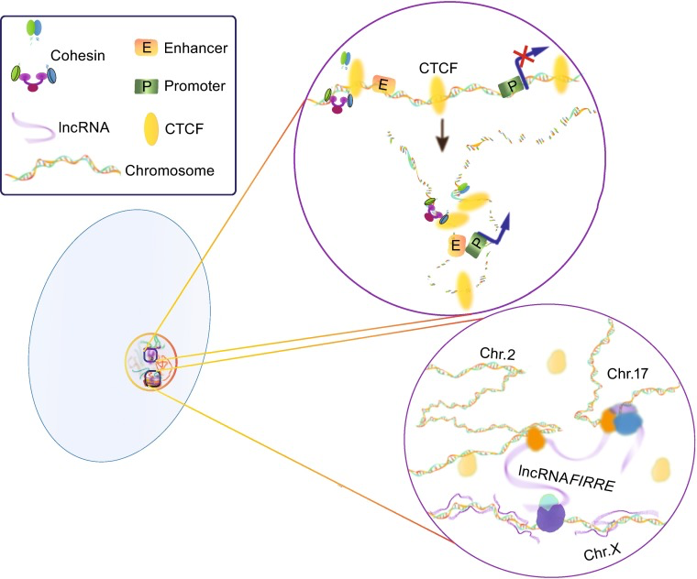
RNA
New era : understanding mechanisms of gene expression
Complex genome topology
A simplified example of how CTCF/cohesion and lncRNAs respectively participate in construction of three-dimensional chromosome network.
(The lncRNA network was modified from Hacisuleyman et al, 2014)
Fatma Guerfali
BCGA course – IPT – 2nd Oct 2017
(Cao et al., 2015. Three-dimensional regulation of transcription )

Slide 50
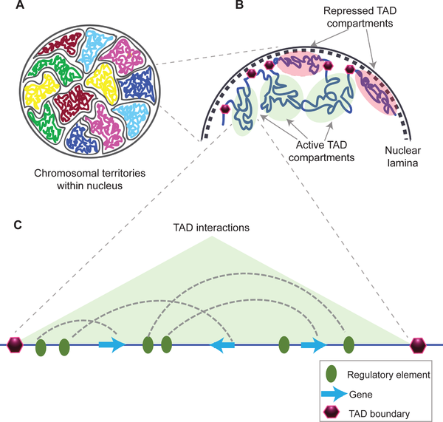
RNA
New era : understanding mechanisms of gene expression
Complex genome topology
A topologically associating domain (TAD) is a self-interacting genomic region = 3D chromosome structures (animals, plants, fungi, bacteria).
TADs can range in size from thousands to millions of DNA bases.
Functions not fully understood, but in some cases, disrupting TADs leads to disease because changes occurring at the 3D organization of the chromosome disrupts gene regulation.
Fatma Guerfali
BCGA course – IPT – 2nd Oct 2017
https://en.wikipedia.org/wiki/Topologically_associating_domain
Notes:
TADs = DNA sequences within a TAD physically interact with each other more frequently than with sequences outside the TAD.^{[1]}
Present in animals, some plants, fungi, bacteria.

Slide 51
RNA
New era : understanding mechanisms of gene expression
non-coding RNAs (ncRNAs)
alternative splicing and posttranslational modifications make a significant contribution to the diversity and functionality of the proteome.
HGP and subsequent high-throughput genomic technologies have demonstrated that only ≈ 2% of the human genome encodes for proteins.
≈ 98% of genome exists as non-protein-coding sequence
Important contribution of ncRNAs to developmental complexity and environmental adaptation (Mattick, 2011). It became clear that probably do not solely rely on protein-mediated three-dimensional transcription.
Fatma Guerfali
BCGA course – IPT – 2nd Oct 2017
(Cao et al., 2015. Three-dimensional regulation of transcription )

Slide 52
RNA
New era : understanding mechanisms of gene expression
non-coding RNAs (ncRNAs)
Decisive role in most, if not all, aspects of gene regulation (epigenetic processes…)
small regulatory ncRNA (<200 nucleotides in length) with major roles in many cellular processes : small interfering RNA (siRNAs), microRNAs (miRNAs)…
long non-coding RNAs (lncRNAs, >200 nucleotides in length) essential regulators in diverse cellular progresses including:
regulation of gene transcription (Orom et al., 2010; Sun et al., 2013),
dosage compensation (Ilik et al., 2013; Maenner et al., 2013)
genomic imprinting (Lee and Bartolomei, 2013; Simon et al., 2013),
DNA damage and nuclear organization (Wan et al., 2013)
Fatma Guerfali
BCGA course – IPT – 2nd Oct 2017
(Cao et al., 2015. Three-dimensional regulation of transcription )

Slide 53
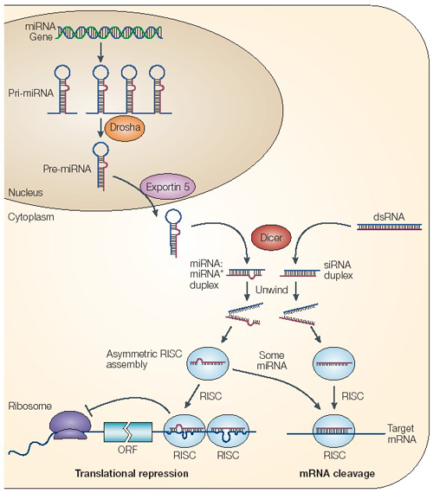
RNA
New era : understanding mechanisms of gene expression
Example of regulation mediated by
microARNs (miRNAs)
Fatma Guerfali
BCGA course – IPT – 2nd Oct 2017
http://www.ozyme.com/_prod/gammes/polyplus/images/micro-arn_schema500.jpg

Slide 54
RNA
New era : understanding mechanisms of gene expression
Example of regulation mediated by
microARNs (miRNAs)
Regulation of Cell Proliferation
Regulation of Metabolic Processes
Regulation of Apoptosis
Fatma Guerfali
BCGA course – IPT – 2nd Oct 2017
microRNAs
Regulation of Genomic instability
Regulation of Multiplication in Cancer Cells
Regulation of Immune Response
http://ars.els-cdn.com/content/image/1-s2.0-S0923253210001080-gr8.jpg

Slide 55
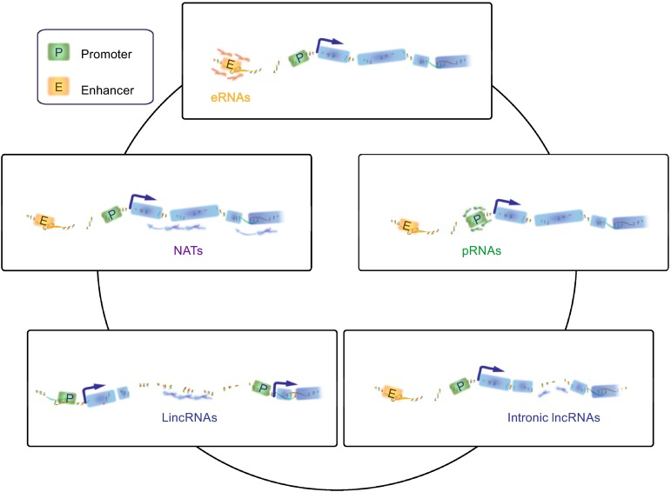
RNA
New era : understanding mechanisms of gene expression
lncRNAs : classification
Based on the genomic localization and context, lncRNAs can be classified as
•eRNAs bidirectional and nonpolyadenylated transcripts transcribed from enhancers
•pRNAs from intragenic promoters
•NATs from the opposite strand of either protein or non-protein coding genes
•lincRNAs from regions intervening protein-coding loci
•intronic lncRNAs from specific introns of protein-coding genes
Fatma Guerfali
BCGA course – IPT – 2nd Oct 2017
(Cao et al., 2015. Three-dimensional regulation of transcription )

Slide 56
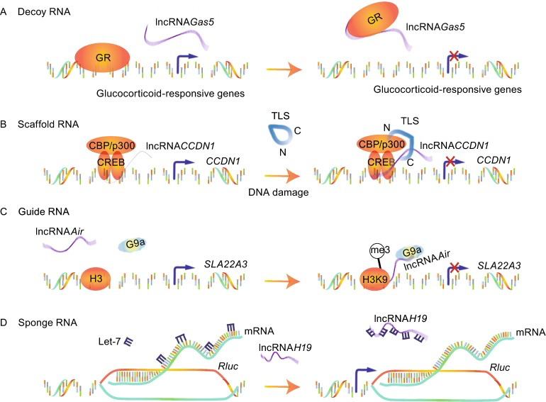
RNA
New era : understanding mechanisms of gene expression
lncRNAs : Regulatory models
Fatma Guerfali
BCGA course – IPT – 2nd Oct 2017
LncRNAs can bind to transcription factors or some other proteins away from chromatin and prevent them from binding to their proper regulatory targets.
Example: lncRNAGas5, transcribed from exon 7 of Gas5 gene, directly interacts with the DNA-binding domain (DBD) of the glucocorticoid receptor (GR) → competes with DNA GREs for binding to the GR DBD.
(Cao et al., 2015. Three-dimensional regulation of transcription )
Notes:
, directly interacts with the DNA-binding domain (DBD) of the glucocorticoid receptor (GR) by acting as a decoy RNA version of the “glucocorticoid response element (GRE)”

Slide 57
RNA
New era : understanding mechanisms of gene expression
lncRNAs : Regulatory models
Fatma Guerfali
BCGA course – IPT – 2nd Oct 2017
lncRNAs have a high structural flexibility → well-suited to assemble diverse combinations of regulatory proteins through specific secondary structures
→ enhance the protein-protein interactions.
Example: lncRNACCND1. It is transcribed from the promoter region of the cyclin D (CCND1) gene. Upon DNA damage → acts as molecular ‘ligand’ for RNA-binding protein TLS → repression of CCND1 transcription.
(Cao et al., 2015. Three-dimensional regulation of transcription )
Notes:
Upon DNA damage, where it acts as molecular ‘ligand’ for RNA-binding protein TLS and promotes an allosteric effect to release it from the inactive conformation. This recruitment of TLS by lncRNACCND1 leads to the inhibition of the HAT functions of CBP/p300 and repression of CCND1 transcription (Wang et al., 2008).

Slide 58
RNA
New era : understanding mechanisms of gene expression
lncRNAs : Regulatory models
Fatma Guerfali
BCGA course – IPT – 2nd Oct 2017
LncRNAs can function in cis on nearby gene or in trans on distally located genes through recruiting chromatin-modifying enzymes to targets.
Example: lncRNAAir, transcribed form an antisense promoter located in intron 2 of Igf2r → silences transcription of the distal Slc22a3 gene via a specific chromosome interaction between Air and the Slc22a3 promoter.
(Cao et al., 2015. Three-dimensional regulation of transcription )
Notes:
Accumulated Air at the Slc22a3 promoter recruits H3K9 histone methyltransferase G9a in placenta and leads to targeted H3K9 methylation and allelic silencing.

Slide 59
RNA
New era : understanding mechanisms of gene expression
lncRNAs : Regulatory models
Fatma Guerfali
BCGA course – IPT – 2nd Oct 2017
LncRNAs could competitively inhibit the ability of miRNAs to interact with their target mRNA.
Example: lncRNAH19, harbors both canonical and noncanonical binding sites for the let-7 family of micro-RNAs → acts as a molecular sponge to specifically sequester endogenous let-7, preventing it from inhibiting Rluc expression
(Cao et al., 2015. Three-dimensional regulation of transcription )

Slide 60
Part 4
Proteins
Fatma Guerfali
BCGA course – IPT – 2nd Oct 2017

Slide 61
Proteins
Definition
Proteins consist of one or more long chains of amino acid residues → large biomolecules, or macromolecules.
Perform a vast array of functions within organisms:
metabolic reactions
DNA replication
response to stimuli
transporting molecules from one location to another…
Proteins are assembled from amino acids using information encoded in genes. Each protein has its own unique amino acid sequence that is specified by the nucleotide sequence of the gene encoding this protein.
In general, the genetic code specifies 20 standard amino acids; however, in certain organisms the genetic code can include selenocysteine and—in certain archaea—pyrrolysine.
Fatma Guerfali
BCGA course – IPT – 2nd Oct 2017
https://en.wikipedia.org/wiki/Protein

Slide 62
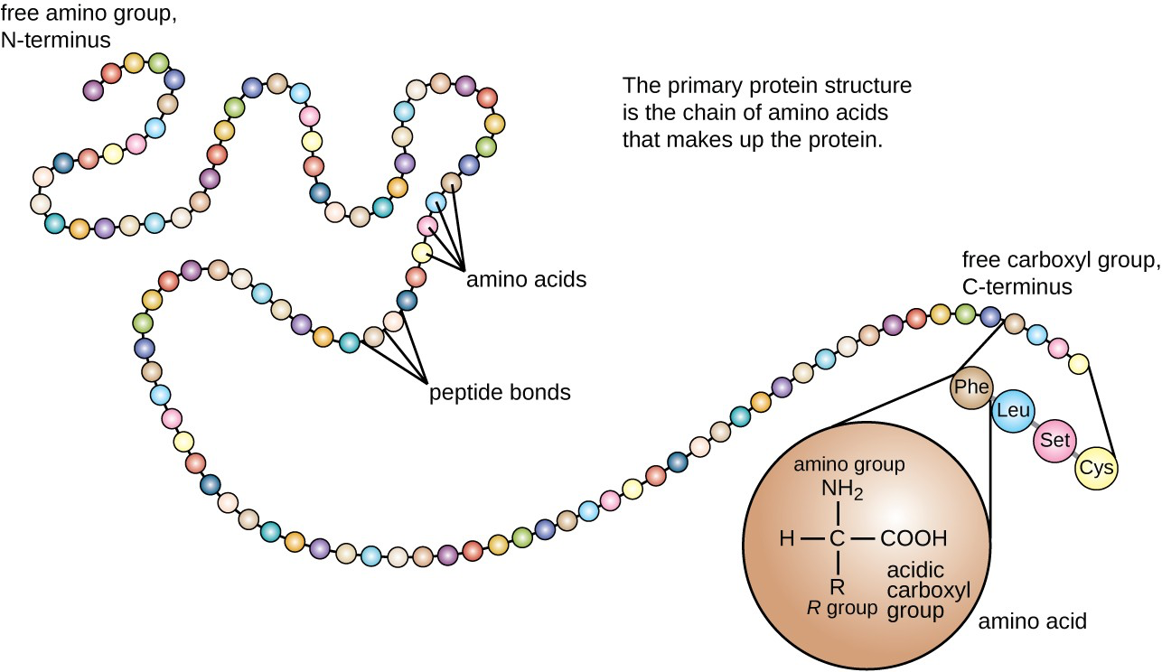
Proteins
Primary structure
A linear chain of amino acid residues is called a polypeptide. A protein contains at least one long polypeptide.
Fatma Guerfali
BCGA course – IPT – 2nd Oct 2017
https://en.wikipedia.org/wiki/Protein
https://courses.lumenlearning.com/microbiology/chapter/proteins/

Slide 63
Proteins
Important
NB: Short polypeptides, containing less than 20–30 residues, are rarely considered to be proteins and are commonly called peptides, or sometimes oligopeptides. The individual amino acid residues are bonded together by peptide bonds and adjacent amino acid residues.
Fatma Guerfali
BCGA course – IPT – 2nd Oct 2017
https://en.wikipedia.org/wiki/Protein

Slide 64
Proteins
Synthesis
Peptides (from Gr.: πεπτός, peptós "digested"; derived from πέσσειν, péssein "to digest") are natural biological or artificially manufactured short chains of amino acid monomers linked by peptide (amide) bonds.
A polypeptide is a long, continuous peptide chain (dipeptides, tripeptides…).
Peptides fall under the broad chemical classes of biological oligomers and polymers, alongside nucleic acids, oligosaccharides and polysaccharides, ….
Oligomers : (oligo:"a few”, mer:"parts") is a molecular complex that consists of a few monomer units, in contrast to a polymer, where the number of monomers is, in principle, unlimited (dimers, trimers, tetramers…)
Polymers: (poly:"many”, mer:"parts"), macromolecule, composed of many repeated subunits = broad range of properties, both synthetic and natural.
Fatma Guerfali
BCGA course – IPT – 2nd Oct 2017
https://en.wikipedia.org/wiki/Peptide

Slide 65
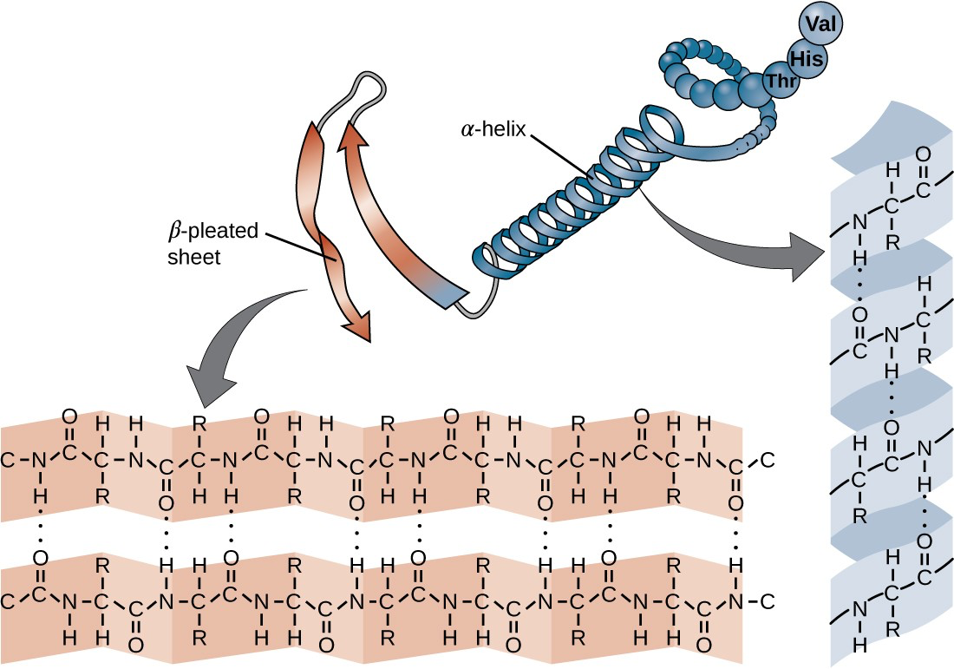
Proteins
Secondary Structure
The chain of amino acids that defines a protein’s primary structure is not rigid.
In long chains hydrogen bonding may occur between amine and carbonyl functional groups within the peptide backbone
→ localized folding of the polypeptide chain into helices and sheets. These shapes constitute a protein’s secondary structure.
Fatma Guerfali
BCGA course – IPT – 2nd Oct 2017
https://en.wikipedia.org/wiki/Protein
https://courses.lumenlearning.com/microbiology/chapter/proteins/

Slide 66
Proteins
Secondary Structure
The most common secondary structures are the α-helix and β-pleated sheet.
Fatma Guerfali
BCGA course – IPT – 2nd Oct 2017
α-helix structure: H-bonds between the O atom in a carbonyl group of one aa and the H atom of the amino group that is just four amino acid units further.
β-pleated sheet, the pleats are formed by similar H bonds between continuous sequences of carbonyl and amino groups that are further separated on the backbone of the polypeptide chain.
https://en.wikipedia.org/wiki/Protein
https://courses.lumenlearning.com/microbiology/chapter/proteins/

Slide 67
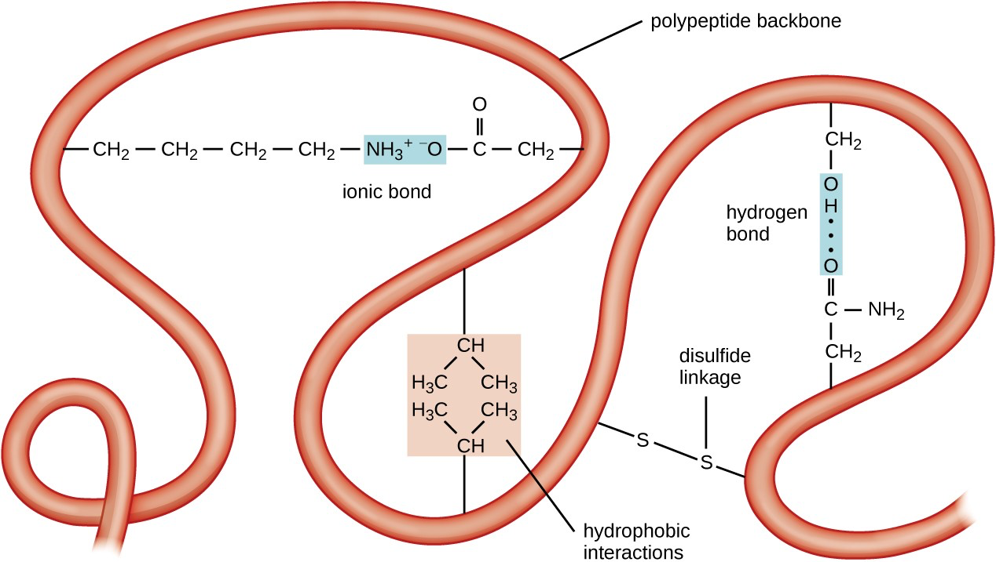
Proteins
Tertiary Structure
the tertiary structure is the large-scale 3D shape of a single polypeptide chain. Tertiary structure is determined by interactions between amino acid residues that are far apart in the chain. A variety of interactions give rise to protein tertiary structure, such as:
disulfide bridges bonds (–SH)
hydrogen bonds
ionic bonds
hydrophobic interactions between nonpolar side chains.
→ These processes determine protein folding.
Fatma Guerfali
BCGA course – IPT – 2nd Oct 2017
All these interactions, weak and strong, combine to determine the final 3D shape of the protein and its function. Folded proteins that are fully functional in their normal biological role are said to possess a native structure.
https://en.wikipedia.org/wiki/Protein
https://courses.lumenlearning.com/microbiology/chapter/proteins/
Notes:
disulfide bridges bonds between the sulfhydryl (–SH) functional groups on amino acid side groups

Slide 68
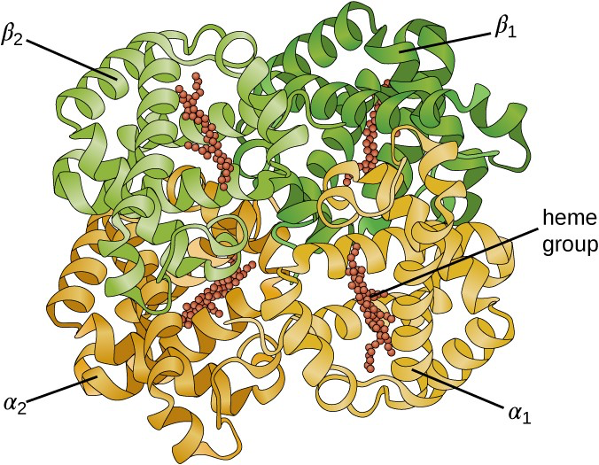
Proteins
Quaternary Structure
Some proteins are assemblies of several separate polypeptides, also known as protein subunits. These proteins function adequately only when all subunits are present and appropriately configured.
The interactions that hold these subunits together constitute the quaternary structure of the protein.
The overall quaternary structure is stabilized by relatively weak interactions.
Example of Hemoglobin: quaternary structure of 4 globular protein subunits.
Fatma Guerfali
BCGA course – IPT – 2nd Oct 2017
https://en.wikipedia.org/wiki/Protein
https://courses.lumenlearning.com/microbiology/chapter/proteins/
Notes:
Example of Hemoglobin: quaternary structure of 4 globular protein subunits: 2 α and 2 β polypeptides, each one containing an iron-based heme

Slide 69
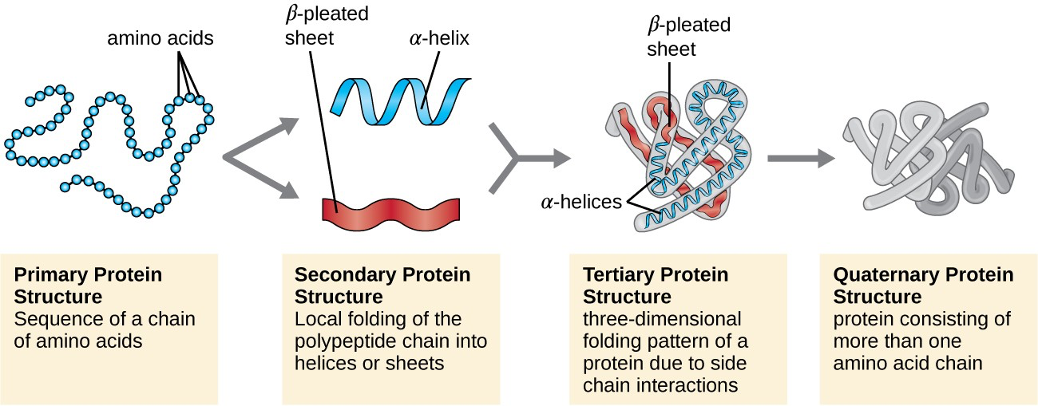
Proteins
In Brief
Fatma Guerfali
BCGA course – IPT – 2nd Oct 2017
https://en.wikipedia.org/wiki/Protein
https://courses.lumenlearning.com/microbiology/chapter/proteins/
Notes:
Example of Hemoglobin: quaternary structure of 4 globular protein subunits: 2 α and 2 β polypeptides, each one containing an iron-based heme

Slide 70
Proteins
Post-translational modifications (PTMs)
Shortly after or even during synthesis, the residues in a protein are often chemically modified by post-translational modification
Post-translational modifications alters:
the physical and chemical properties
Folding
Stability
Activity
Function of the proteins.
Proteins can also work together to achieve a particular function, and they often associate to form stable protein complexes.
Sometimes proteins have non-peptide groups attached, which can be called prosthetic groups or cofactors = conjugated proteins.
Fatma Guerfali
BCGA course – IPT – 2nd Oct 2017
https://en.wikipedia.org/wiki/Protein

Slide 71
Proteins
Conjugated Proteins
Important class of proteins is the conjugated proteins that have a non-protein portion.
If the conjugated protein has a carbohydrate attached, it is called a glycoprotein.
If it has a lipid attached, it is called a lipoprotein.
These proteins are important components of membranes.
Fatma Guerfali
BCGA course – IPT – 2nd Oct 2017
https://en.wikipedia.org/wiki/Protein
https://courses.lumenlearning.com/microbiology/chapter/proteins/
Notes:
Example of Hemoglobin: quaternary structure of 4 globular protein subunits: 2 α and 2 β polypeptides, each one containing an iron-based heme

Slide 72
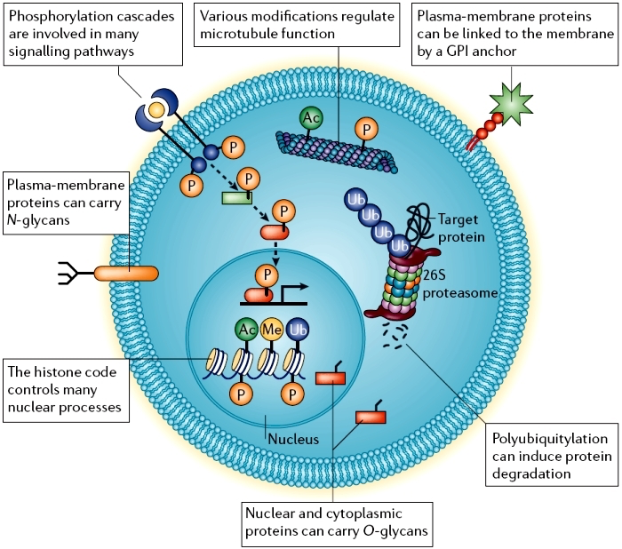
Proteins
Post-translational modifications (PTMs)
Fatma Guerfali
BCGA course – IPT – 2nd Oct 2017
https://www.nature.com/scitable/content/cellular-post-translational-modifications-99009

Slide 73
Proteins
Abundance in cells
average-sized bacteria ≈ 2 million proteins per cell (e.g. E. coli, S. aureus).
Smaller bacteria contain fewer molecules ≈ 50,000 to 1 million (e.g. Mycoplasma, spirochetes).
Eukaryotic cells are larger and thus contain much more protein:
≈ 50 million proteins in yeast cells
≈ 1 to 3 billion in human cells.
The concentration of individual protein copies ranges from a few molecules per cell up to 20 million
→ depends on the number of genes expressed (cell type, external stimuli…)
Fatma Guerfali
BCGA course – IPT – 2nd Oct 2017
http://onlinelibrary.wiley.com/doi/10.1002/bies.201300066/full
http://kirschner.med.harvard.edu/files/bionumbers/fundamentalBioNumbersHandout.pdf
http://msb.embopress.org/content/7/1/549
http://www.nature.com/nature/journal/v499/n7456/full/nature12223.html?foxtrotcallback=true
https://en.wikipedia.org/wiki/Protein

Slide 74
Proteins
The Codon Bias
Definition
Codon bias is the tendency of genomes to prefer one particular codon for an amino acid over all the others.
Evolutionary importance of codon bias
Measure of the Codon Adaptation Index (CAI) : the geometric weight of a specific codon over the whole geometric weight of the genome
Comparison of CAI among different organisms:
codons with the highest CAI's represented the preferred codon, or the codon that receives the bias, and these were codons rich in Guanine and Cytosine.
GC-rich genomes : GC bases seems evolutionarily superior.
Fatma Guerfali
BCGA course – IPT – 2nd Oct 2017
https://en.wikipedia.org/wiki/Wobble_base_pair
Notes:
A codon table sets out how the triplet codons code for specific amino acids.

Slide 75
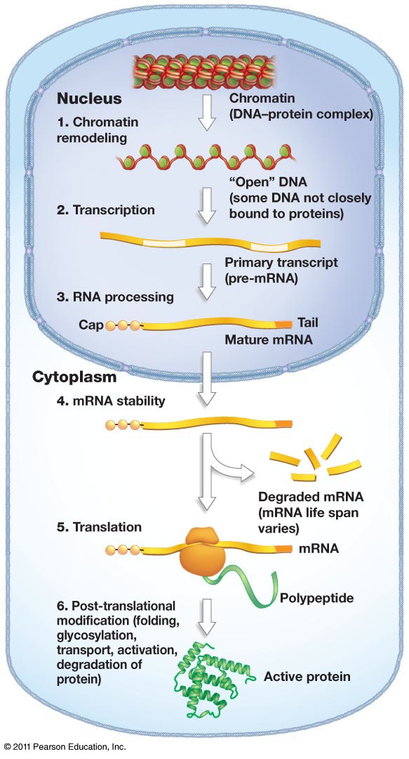
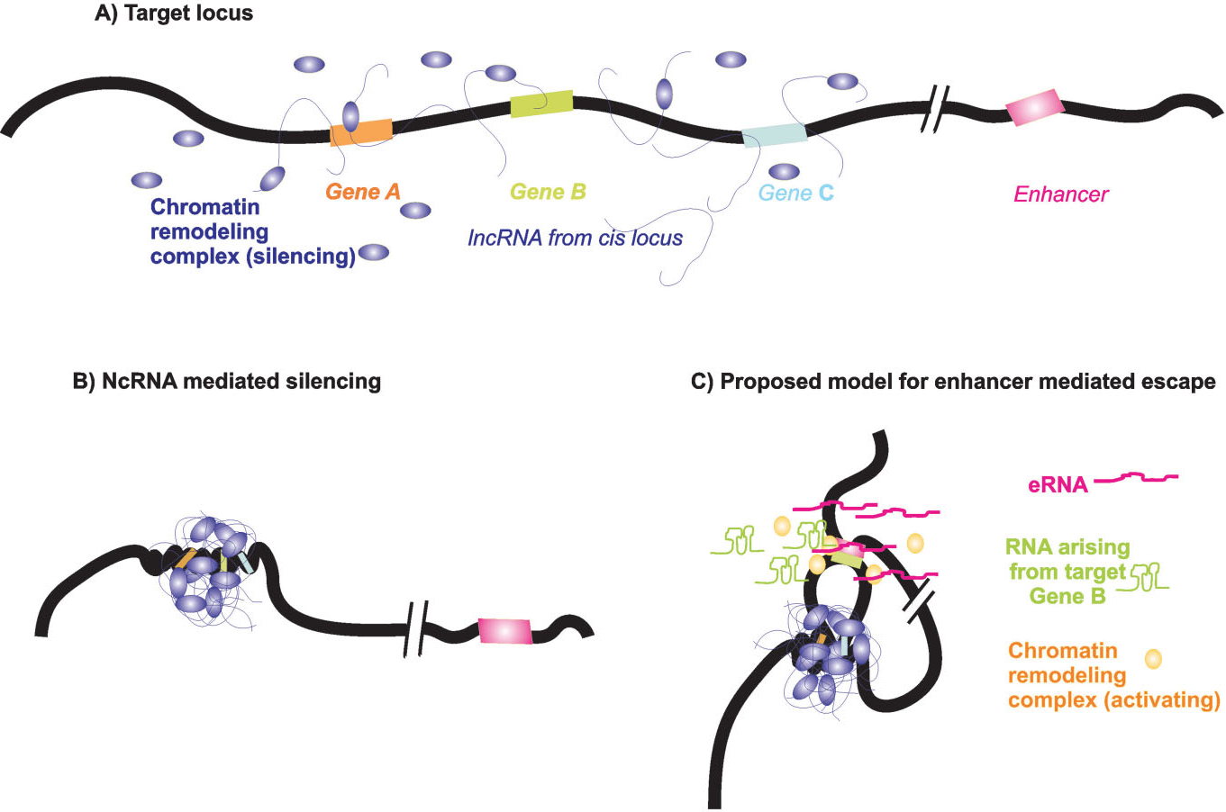
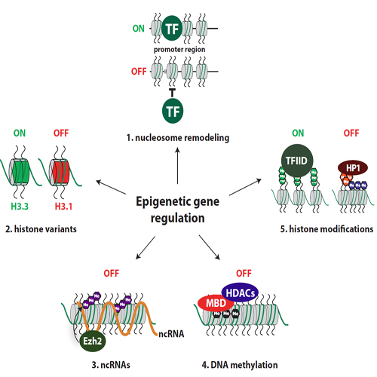
Overview of regulation processes
Methods used by eukaryotes for gene regulation
A regulation with several coding levels
lncRNA mediated silencing
Acetylation
Ubiquitination
Methylation
Phosphorylation
Degradation
(…)
+
Response to stimuli
Transcription initiation
Fatma Guerfali
BCGA course – IPT – 2nd Oct 2017
Epigenetic regulation
http://www.oryzon.com
XXX

Slide 76
Part 5
Point mutations and their consequences
Fatma Guerfali
BCGA course – IPT – 2nd Oct 2017

Slide 77
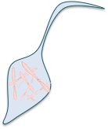


Point mutations and their consequences
Genomic Structural Variations (SV)
WHOLE CELL TO WHOLE POPULATION
1kb TO SUB- MICROSCOPIC
CYTOGENETIC DETECTION
Fatma Guerfali
BCGA course – IPT – 2nd Oct 2017
REFERENCE
SUB-CHROMOSOMAL TO MICROSCOPIC
WHOLE CHRs TO WHOLE GENOMES
SINGLE NUCLEOTIDE
2bp TO
1,000 BP
REFERENCE
REFERENCE
MOLECULAR GENETIC DETECTION
Notes:
What are the different point mutations and how can they be classified ?
What are their consequences ?

Slide 78
Point mutations and their consequences
Classification
Chromosomal mutations:
Affects entire chromosomes or entire portions of it. Sometimes called segmental mutations
Point mutations:
Affects 1 or few base-pairs. Consists of
Substitutions : change of 1 or few nucleotides in an existing sequence
Insertions: addition of 1 or few nucleotides in an existing sequence
Deletions: loss of 1 or few nucleotidesin an existing sequence
Fatma Guerfali
BCGA course – IPT – 2nd Oct 2017
Adapted from web resources
Notes:
What are the different point mutations and how can they be classified ?
What are their consequences ?

Slide 79
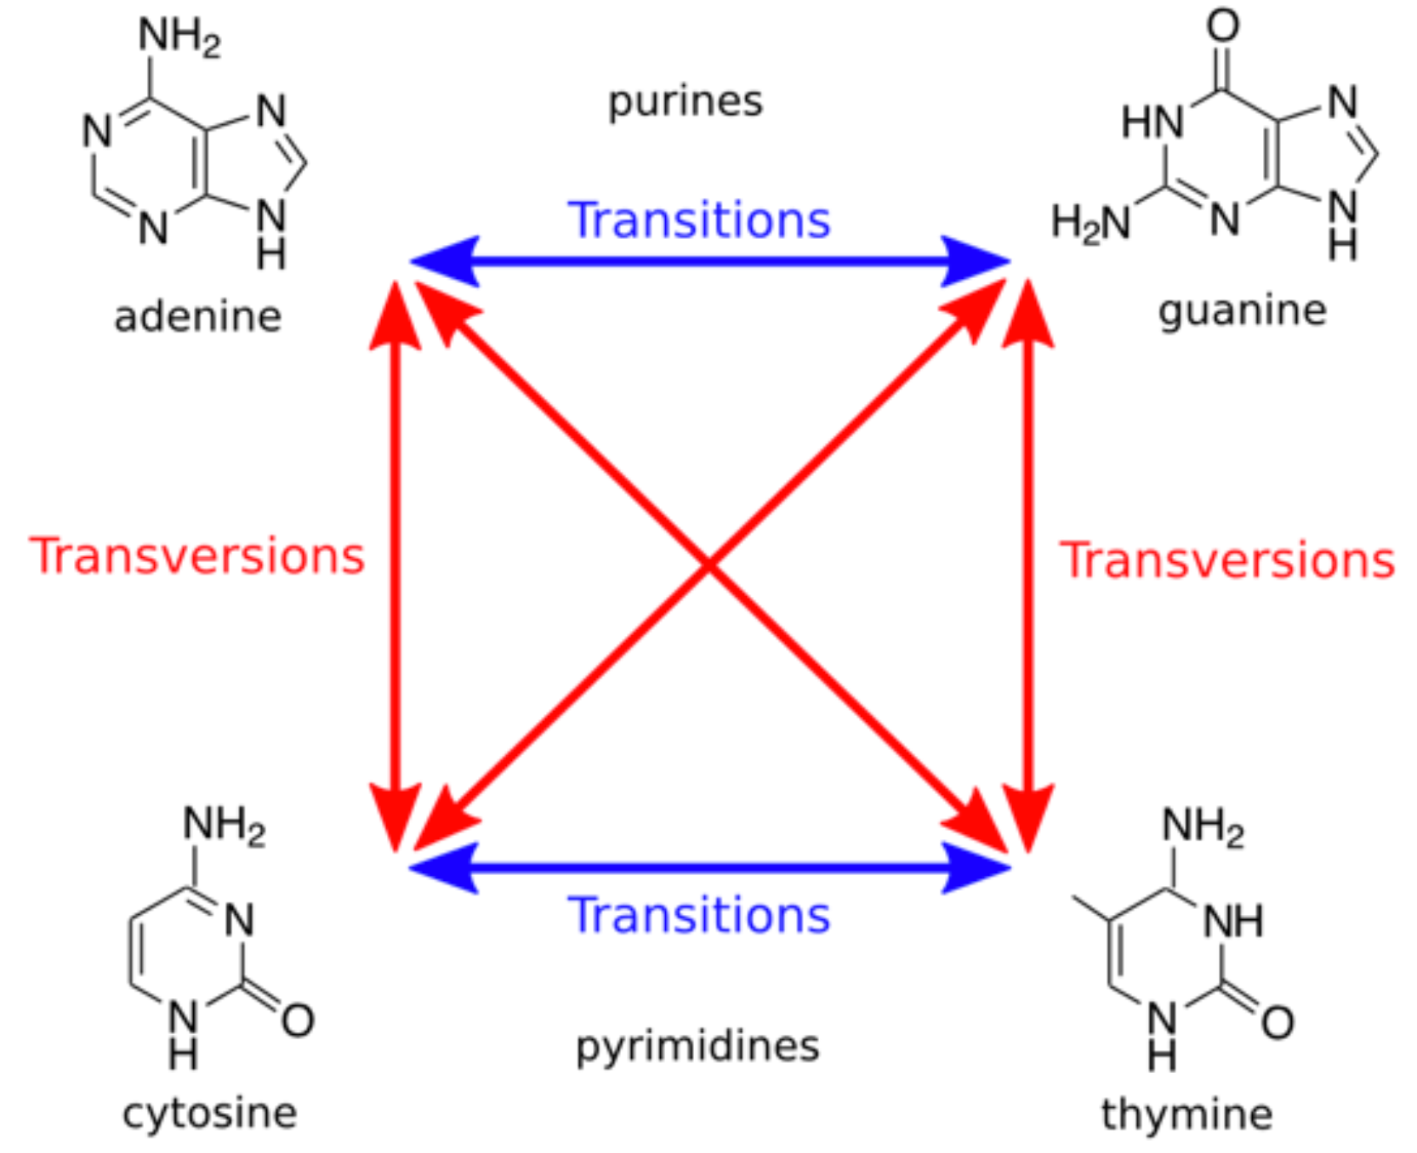
Point mutations and their consequences
Substitutions
Transition
Substitution of a
(Pyrimidine → Pyrimidine)
or (Purine → Purine)
Transversion
Substitution of a
(Pyrimidine → Purine)
or (Purine → Pyrimidine)
Fatma Guerfali
BCGA course – IPT – 2nd Oct 2017
Adapted from web resources
Notes:
What are the different point mutations and how can they be classified ?
What are their consequences ?

Slide 80
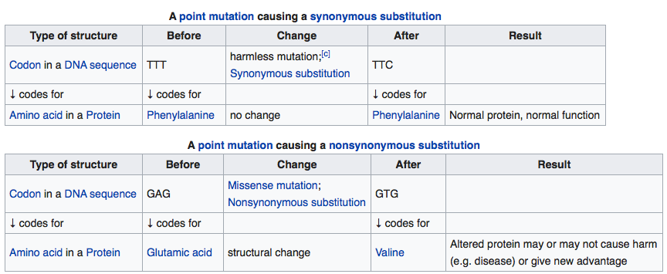
Point mutations and their consequences
Substitutions
Synonymous mutations
A synonymous codon is one that, if mutated, would still code for the same amino acid.
This is possible because the genetic code is "degenerate”.
In most cases, if the last nucleotide in the codon is changed it generally codes for the same amino acid
Fatma Guerfali
BCGA course – IPT – 2nd Oct 2017
https://en.wikipedia.org/wiki/Wobble_base_pair
https://en.wikipedia.org/wiki/Ka/Ks_ratio

Slide 81
Point mutations and their consequences
Substitutions
Non-Synonymous mutations
A base pair is changed, and the codon codes for a different amino acid.
If the mutation is for an amino acid with similar qualities, such as hydrophobic or polar tendencies, then there is a strong possibility that the resulting protein will resemble much of the same structure.
Fatma Guerfali
BCGA course – IPT – 2nd Oct 2017
https://en.wikipedia.org/wiki/Wobble_base_pair
https://en.wikipedia.org/wiki/Ka/Ks_ratio
Notes:
Example of sickle-cell disease : a single nucleotide polymorphism that results in an amino acid switch from glutamine to valine and that yields an entirely sickled red blood cell with limited capacity to carry oxygen.

Slide 82
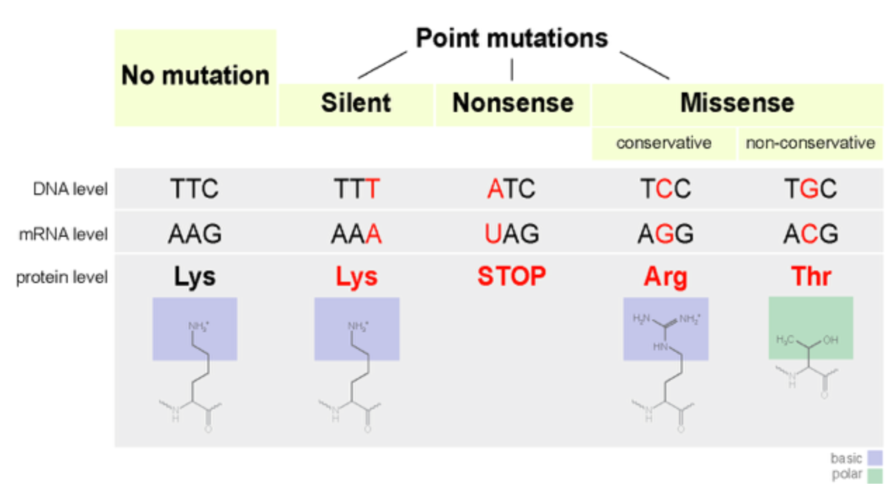
Point mutations and their consequences
Substitutions in the coding genome
Fatma Guerfali
BCGA course – IPT – 2nd Oct 2017
Adapted from web resources

Slide 83
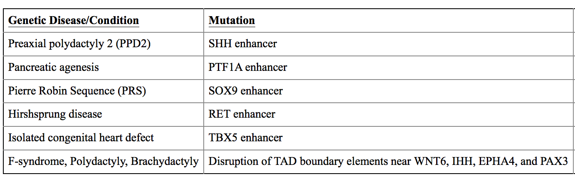
Point mutations and their consequences
Substitutions in the non-coding genome
Sequencing the coding region, or exome, of individuals suspected of having a genetic disorder identifies 25–50% of disease-associated mutations. This leaves the genetic etiology of many cases undetermined → role in non-coding?
Functional regulatory elements (enhancers…) in non-coding regions of the genome are associated with congenital anomalies
Fatma Guerfali
BCGA course – IPT – 2nd Oct 2017
Examples of genetic conditions caused by mutations outside the exome
(Scacheri & Scacheri, 2015. Mutations in the non-coding genome)

Slide 84
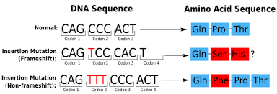
Point mutations and their consequences
Insertion/Deletion (InDels)
In-frame mutation if the successive order of codons is maintained
Frameshift mutation if the sequence is changed or a premature stop codon appears.
Fatma Guerfali
BCGA course – IPT – 2nd Oct 2017
Adapted from web resources
Notes:
What are the different point mutations and how can they be classified ?
What are their consequences ?

Slide 85
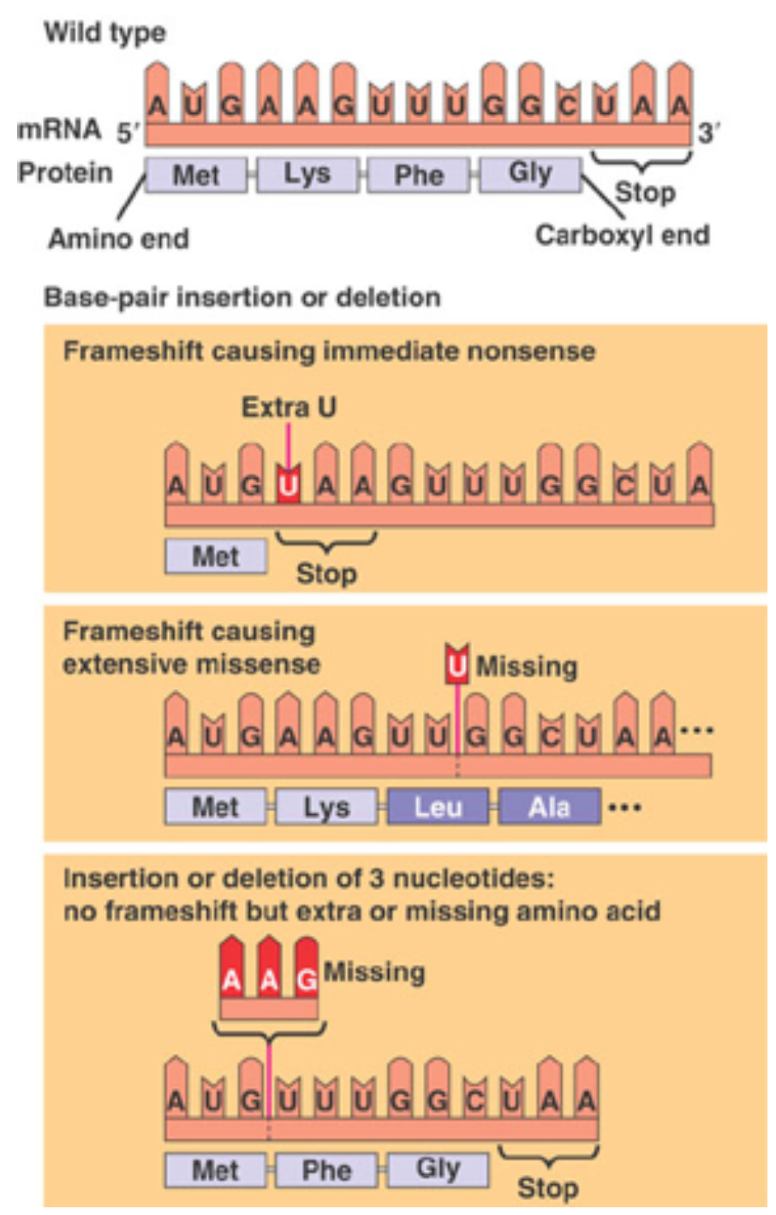
Point mutations and their consequences
Insertion/Deletion (InDels)
Fatma Guerfali
BCGA course – IPT – 2nd Oct 2017
Adapted from web resources
Notes:
What are the different point mutations and how can they be classified ?
What are their consequences ?

Slide 86
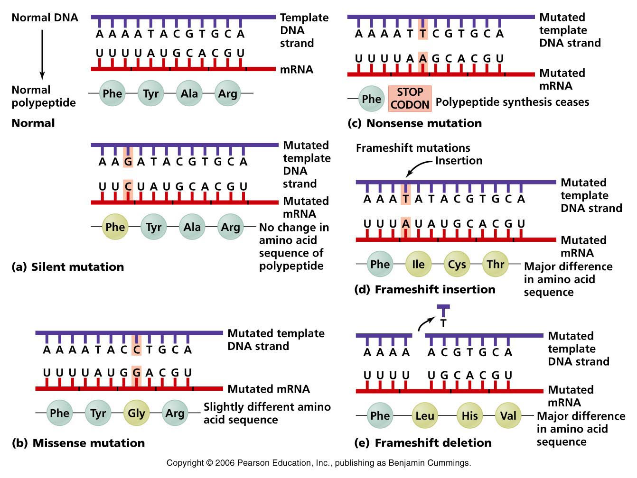
Point mutations and their consequences
Summary
Fatma Guerfali
BCGA course – IPT – 2nd Oct 2017
http://academic.pgcc.edu/~kroberts/Lecture/Chapter%207/mutation.html

Slide 87
Point mutations and their consequences
Patterns of Codon usage and Synonymous mutations
Codon usage can vary dramatically even within a single gene.
Synonymous mutations at specific sites may experience selection because they disrupt motifs recognized by TFs or by PTMs.
Codon choice that promotes proper nucleosome positioning is selectively advantageous in eukaryotes, especially in 5′ regions (Warnecke et al., 2008).
In mammals, synonymous mutations near an intron–exon boundary can create spurious splice sites or disrupt splicing-control elements, causing disease.
This phenomenon helps to explain the reduced rate of synonymous substitutions and SNP density near splicing control elements.
Fatma Guerfali
BCGA course – IPT – 2nd Oct 2017
(Warnecke et al., 2008)
(Chamary et al., 2006)
https://en.wikipedia.org/wiki/Wobble_base_pair
Notes:
A codon table sets out how the triplet codons code for specific amino acids.

Slide 88
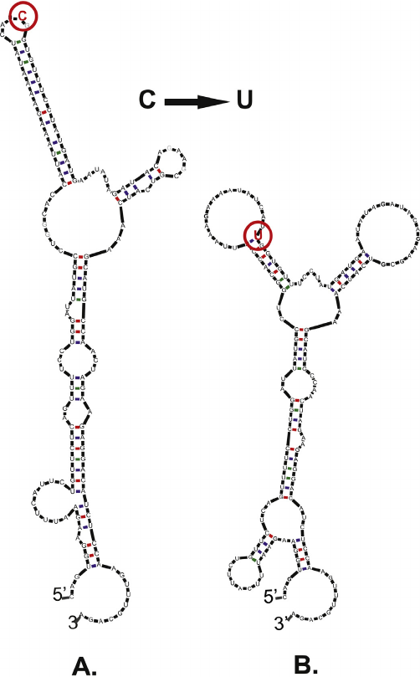
Point mutations and their consequences
Patterns of Codon usage and Synonymous mutations
Synonymous mutations can affect mRNA structure
Consequences of a synonymous single nucleotide change on the predicted structure of the mRNA (mfold).
Fatma Guerfali
BCGA course – IPT – 2nd Oct 2017
(Bali et al., 2015)
Notes:
The predicted (mfold) structures of the Ile507-ATC and Ile507-ATT F508 CFTR mRNAs. The sequences represent human CFTR mRNA fragments encoding the region of NBD1 near the F508 mutation.

Slide 89
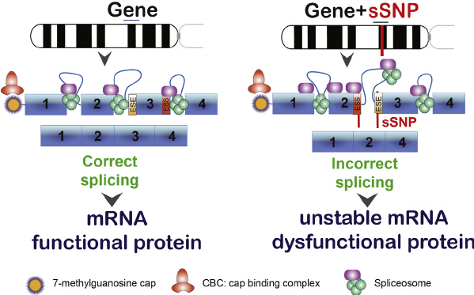
Point mutations and their consequences
Patterns of Codon usage and Synonymous mutations
Synonymous mutations can affect exonic splice regulatory sites
The occurrences of synonymous codons vary between species and within genes of the same genome, known as codon usage bias.
Fatma Guerfali
BCGA course – IPT – 2nd Oct 2017
(Bali et al., 2015)
Notes:
The consequence of synonymous mutations in exonic splice regulatory sites. sSNPs may disrupt critical elements necessary for splicing. In the example shown, this results in exon skipping.

Slide 90
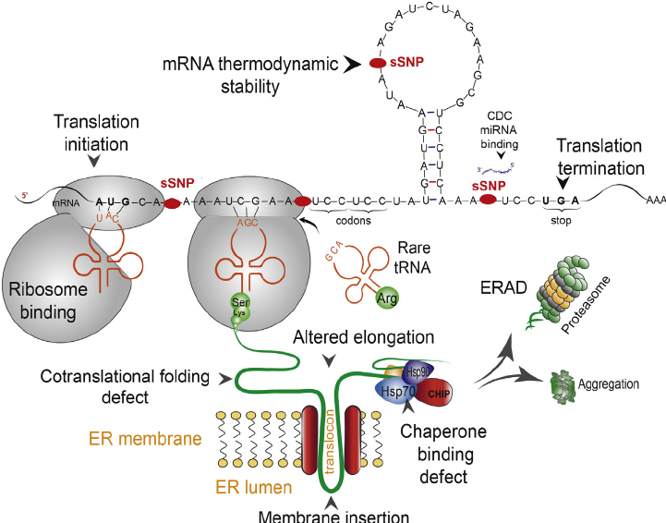
Point mutations and their consequences
Patterns of Codon usage and Synonymous mutations
Synonymous mutations can affect proteins at various synthesis steps. Can alter:
translation
initiation efficiency
translation
elongation rate
ribosomal
pause rhythm
cotranslational
folding
→ the overall fate of the protein.
Fatma Guerfali
BCGA course – IPT – 2nd Oct 2017
(Bali et al., 2015)
Notes:
Different steps of translation and cotranslational protein folding affected by synonymous mutation. sSNPs may alter translation initiation efficiency, translation elongation rate, ribosomal pause rhythm, cotranslational folding or the overall fate of the protein.

Slide 91

Point mutations and their consequences
Patterns of Codon usage and Synonymous mutations
Synonymous Codons can affect gene expression and protein structure
Ribosome profiling experiments → ribosome occupancy time is not the same for different synonymous codons.
Fatma Guerfali
BCGA course – IPT – 2nd Oct 2017
Conclusion:
Synonymous codons influence differently the speed of translation elongation
This guides further cotranslational folding kinetics of a protein.
It is now realized that the position of each codon in a coding sequence is important.
(Mitra et al., 2016)
Notes:
Relation between synonymous mutation and cotranslational protein folding: its effects on various factors controlling translation speed

Slide 92
Concluding remarks
Complexity and definitions in constant evolution
Complex regulatory picture since HGP and associated projects
Dogmas in constant revision
Novel key findings at the level of DNA, RNA and Proteins
→ Keep updated !
Fatma Guerfali
BCGA course – IPT – 2nd Oct 2017
Notes:
Relation between synonymous mutation and cotranslational protein folding: its effects on various factors controlling translation speed

Slide 93

Remember: Dialectic method
Use Socrates method
The method invented by Socrates is the
dialectic: the art of asking oriented questions
to reach the truth.
Dialectics is not knowledge but the
method by which it can be achieved.
Socrates' method aims to help each one find the truth he is seeking. Aware of being imperfect, Socrates constantly seeks to improve himself by constantly revisiting his knowledge.
It does not rise on the pedestal of the one who knows, it defies daily its own ignorance to be able to advance.
Fatma Guerfali
BCGA course – IPT – 2nd Oct 2017
Adapted from web resources
Notes:
What are the different point mutations and how can they be classified ?
What are their consequences ?

Slide 95

In genetics, a missense mutation is a point mutation in which a single nucleotide change results in a codon that codes for a different amino acid.[1] It is a type of nonsynonymous substitution. Missense mutations can render the resulting protein nonfunctional,[2] and such mutations are responsible for human diseases such as Epidermolysis bullosa, sickle-cell disease, and SOD1 mediated ALS
https://en.wikipedia.org/wiki/Missense_mutation

Slide 96
Not all missense mutations lead to appreciable protein changes.
An amino acid may be replaced by an amino acid of very similar chemical properties, in which case, the protein may still function normally; this is termed a neutral, "quiet", "silent" or conservative mutation.
Alternatively, the amino acid substitution could occur in a region of the protein which does not significantly affect the protein secondary structure or function. When an amino acid may be encoded by more than one codon (so-called "degenerate coding") a mutation in a codon may not produce any change in translation; this would be a silent mutation (a type of synonymous substitution, which is not always silent) and not a missense mutation.
https://en.wikipedia.org/wiki/Missense_mutation

Slide 97

Another type of nonsynonymous substitution is a nonsense mutation in which a codon is changed to a premature stop codon that results in truncation of the resulting protein.
https://en.wikipedia.org/wiki/Missense_mutation

Slide 98

Luo, 2015: The Use of Evolutionary Approaches to Understand Single Cell Genomes
Notes:
Figure 1: Examples of non-synonymous and synonymous nucleotide substitutions (A) and examples of radical and conservative non-synonymous nucleotide substitutions (B). In the former, a non-synonymous substitution leads to an amino acid replacement, and a synonymous substitution does not. In the latter, the 20 amino acids show different physicochemical properties, such as charge. A radical non-synonymous substitution leads to an amino acid replacement with a concomitant change in charge, and a conservative non-synonymous substitution leads to an amino acid replacement without a change in charge.

Slide 99
La méthode inventée par Socrate est la dialectique : l’art de faire dialoguer deux discours
apparemment contradictoires pour accéder à une vérité supérieure. Grâce à un jeu progressif de questions, Socrate fait tomber les fausses connaissances de l’interlocuteur.
La dialectique n’est pas le savoir mais la méthode qui permet d’y parvenir.
Désintéressée et dénuée d’égoïsme, la méthode de Socrate vise à aider chacun à trouver sa propre voie et loi d’action. Conscient d’être imparfait, Socrate cherche sans cesse à se perfectionner. Il ne se hisse pas sur le piédestal de celui qui sait, il défie quotidiennement sa propre ignorance pour pouvoir avancer. Ce faisant, il assume la contradiction apparente qui consiste à mettre en pratique un savoir ou une technique qu’il ne domine pas encore entièrement. Son attitude de vie relève d’une philosophie du risque assumé. Il ne tombe pas dans le piège psychologique d’agir seulement lorsqu’il croit tout savoir et que le risque est nul, ce qui empêche précisément nombre de personnes, paralysées par le syndrome de la perfection, de passer à l’action. Sans confrontation, nul ne peut apprendre ni se perfectionner en quoi que ce soit. Socrate comprend qu’on ne peut jamais être totalement préparé à l’action dans la théorie et que, dans la réalité, ce qui permet d’être prêt est la décision d’agir tout en étant conscient de sa propre imperfection, en apprenant de ce qu’on expérimente, qu’on gagne ou qu’on perde. Le succès selon Socrate réside dans le fait d’avoir le courage et l’intelligence de se confronter à ses peurs et à ses doutes, en les dépassant.
La relation établie par le dialogue est celle de deux individus qui communiquent entre eux à travers deux consciences pratiquant l’investigation et entrant en relation pour parvenir à atteindre une vérité commune.
http://www.sagesse-marseille.com/lhomme-sage/philosophie-dans-la-vie/la-methode-socratique.html

